Slide 1


Notes for Teachers/Tutors
Approx time of lesson plan 20 mins
Teacher resources laptop, projector, logins and PDF (see notes)
Learner resources KC login info, access to internet and device
Suitable for groups (2-35 learners recommended)
Style of teaching listening and participation
Notes:
NOTES
1. Learners' login details may have been emailed out to them or printed in a business card style that need to be handed out. If you have any learners that have logins missing, you can give the KentChoices team a call on 03301 651 120.
2. There is a PDF you can print off with tips on writing a personal statement visit:-
https://www.kentprospectus.co.uk/resources/detail/writing-your-personal-statement-622

Slide 2


Session Aims for Teachers/Tutors
Best used after Intro to KentChoices Lesson Plan.
Supports Year 10’s logging on to their KentChoices accounts.
Learners update basic information in preparation to apply in Year 11.
Eases pressure for schools and learners during the busy autumn term.
Notes:
This presentation follows on from the Introduction to KentChoices Lesson Plan.
It aims to support you with logging your Year 10’s onto their KentChoices accounts and covers how learners add their basic information to their profile.
Starting the process in Year 10, can ease the pressure at the start of autumn term and help both schools and learners be prepared for making applications in Year 11.

Slide 3
Session Aims for Learners
Logged onto their KentChoices accounts.
Start updating profile (Add contact details so they can retrieve login details)
Be familiar with site
Ready to search and apply from launch. (1 Nov 2024)
Notes:
By the end of the session learners should have logged onto their KentChoices accounts, start updating their profile ensuring they add their contact details so they can easily retrieve their login details in future.
They’ll become familiar with the site and be ready to search and apply for their post 16 opportunities from 1 Nov 2024. (They can search but won’t be able to apply until they are in Year 11)

Slide 4
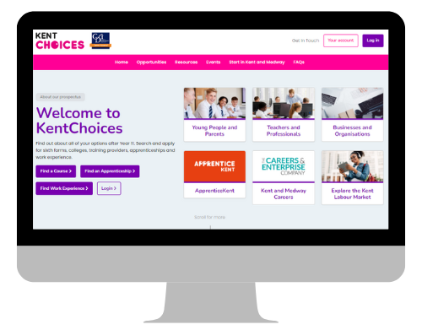
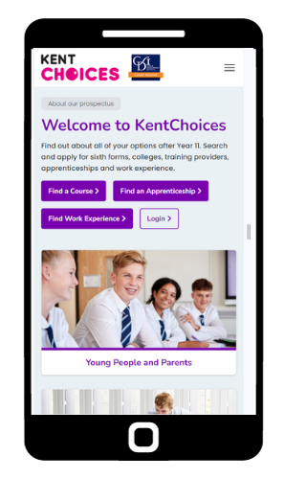
KentChoices
Login Session for Year 10’s
The Education People working in partnership with Kent County Council
Notes:
Please note – There are some animations throughout the presentation. These are highlighted and have an asterisk * to prompt the best time to use.

Slide 5
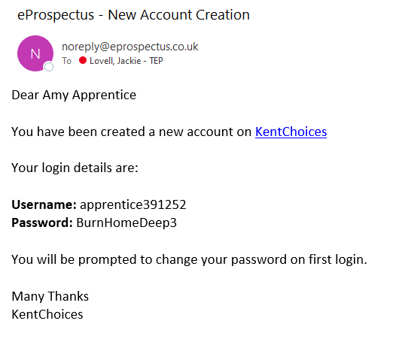
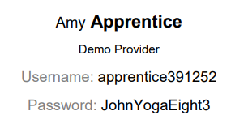
Your Login Details
Email option Print out option
Notes:
Have you got your login details? If they were emailed out to you, look out for an email from eprospectus, otherwise they will be on a paper slip.

Slide 6
Keep Your Login Details Safe
Make and track applications.
Send and receive messages.
Accept interview dates and offers
You’ll need them all year to:-
Notes:
Make sure to keep your login details safe. You’ll need them throughout the year to make and track your applications, view messages and accept interviews and offers so it’s important you keep a note of them.

Slide 7

Top Tip!!
Notes:
Our top tip is to take a picture!*

Slide 8
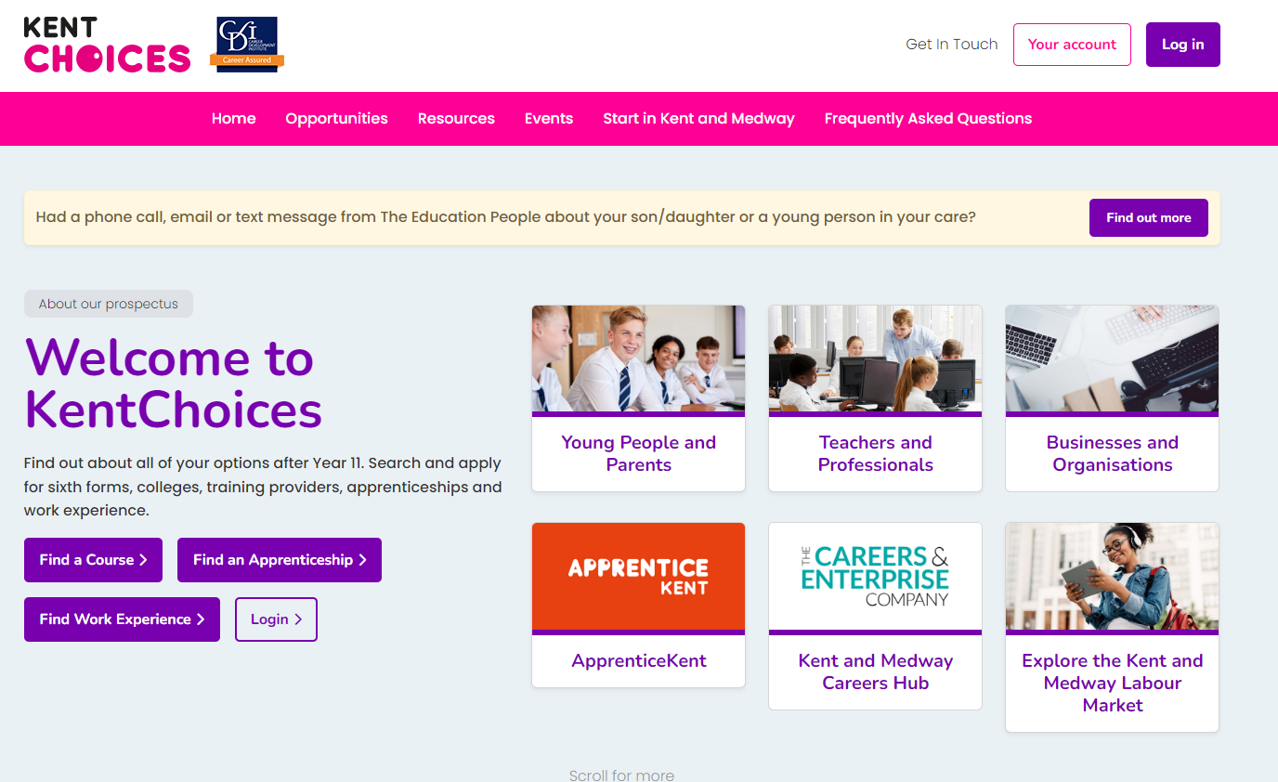



Let’s Get Logged On!
Notes:
Go to KentChoices.co.uk and click Log in* to get started

Slide 9
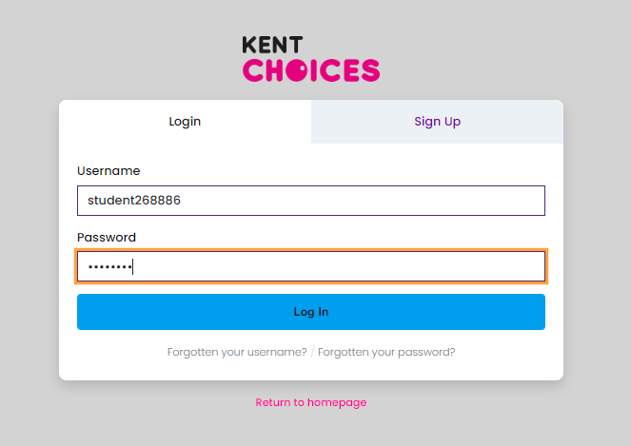

Log In
Notes:
Enter your details and click Log In

Slide 10
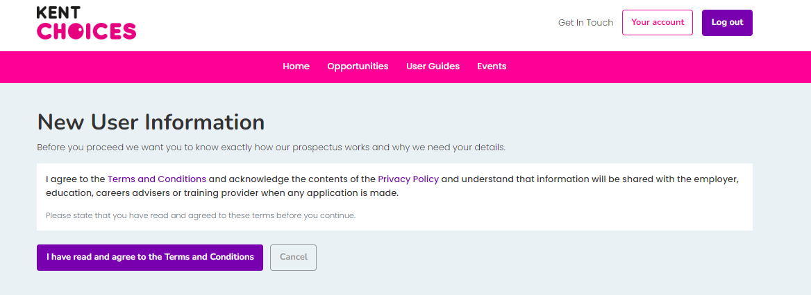
Agree to Terms and Conditions
Notes:
Agree to the terms and conditions.

Slide 11

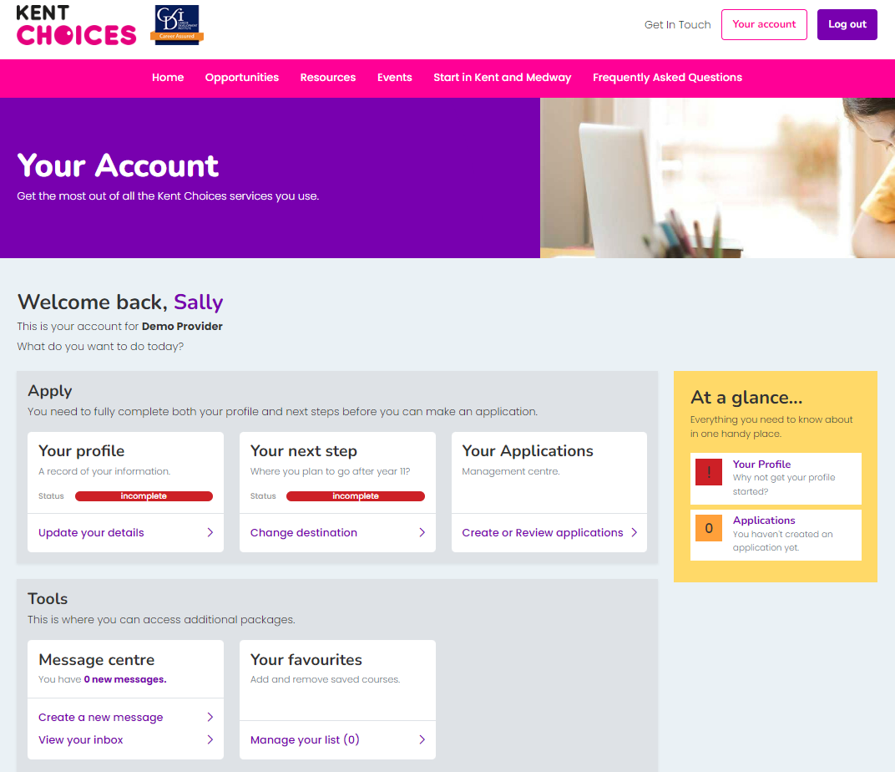
Your Account Dashboard
Notes:
This is Your Account Dashboard – You’ll land on this page whenever you log on.
You can come back to this page any time by clicking on Your account * when logged on.

Slide 12
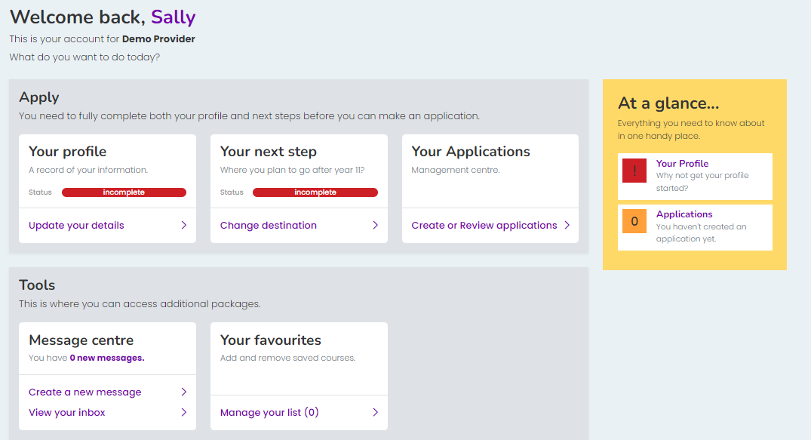

Complete Your Profile
Notes:
Let's start by completing Your Profile. Click Update your details *

Slide 13
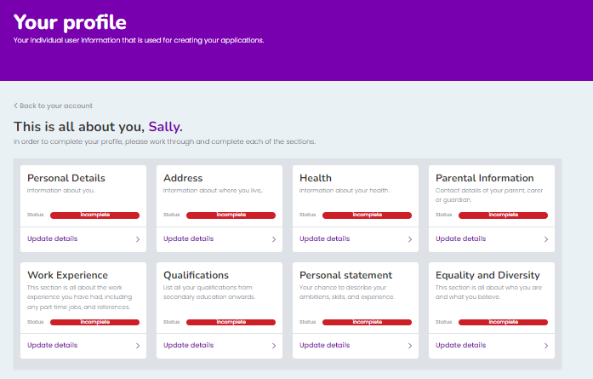
Your Profile
Good preparation
Helps providers decide
Template for all apps
Notes:
Adding your information now is good preparation for when you’re in Year 11 and can help sixth forms and colleges make a better decision about your application.
If you apply to more than one provider, it saves you entering this information multiple times.
In the Personal Details box, click Update Details *

Slide 14
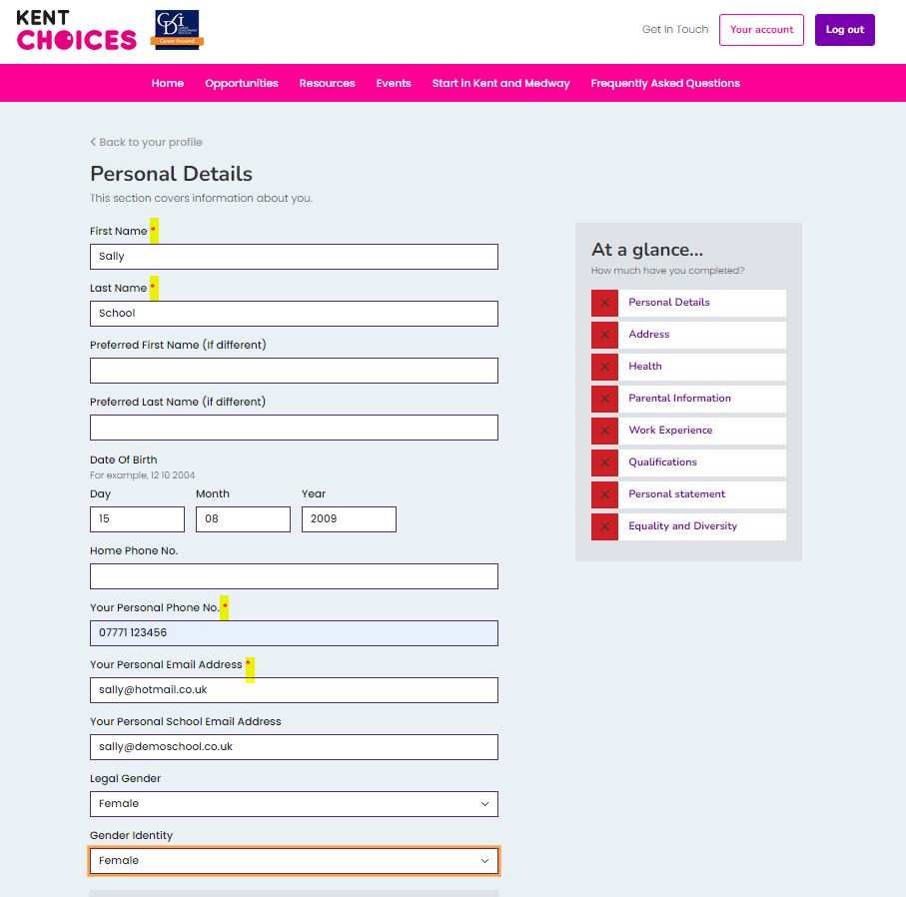
Personal Details
Check your info
Update and add
Complete all fields with a *
Notes:
Check any pre-populated information. You can change details if they are incorrect.
You need to complete all fields marked with a red asterisk.

Slide 15
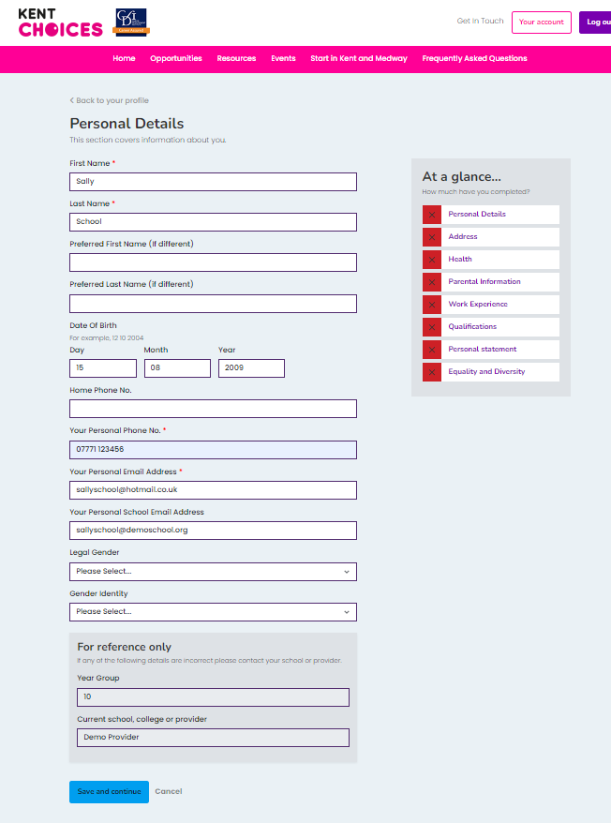
Add Your Contact Details
*** IMPORTANT ***
Providers need to contact you!
Add a mobile number
Add at least one email address
Notes:
Make sure you add a telephone number and a personal or school email address, so sixth forms and colleges can contact you about your application. Click Save and Continue* when you’re done.

Slide 16
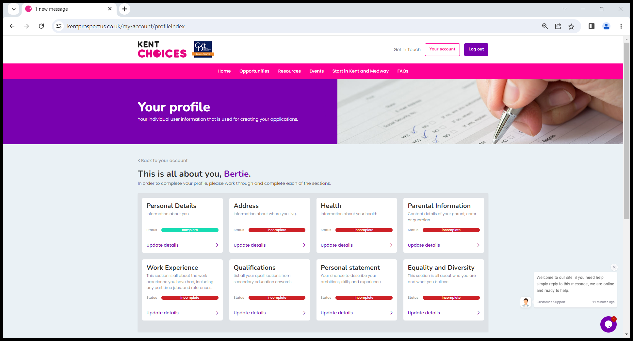
Work Through All Sections
Notes:
Work through all the sections until they turn green.

Slide 17
Tips - Completing Your Profile
You can update or add info later
Don’t know your parents email address? Add your own for the moment
Don’t forget to add any work experience you’ve done or about to do
Notes:
If you don’t know your parents email address you can enter your own for the time being – just remember to change this later.
Add any work experience you’ve done or if you are about to do.
Don’t worry if you can’t complete all the information, you can come back and update or add information later if you need to.

Slide 18
Keep It Professional!!
Information used to help providers make their decision
Is your email address suitable?
Check your spelling and grammar are correct
Notes:
Information you provide will be used to help sixth forms and colleges make a decision about your application so keep it professional and remember to check your spelling and grammar.

Slide 19
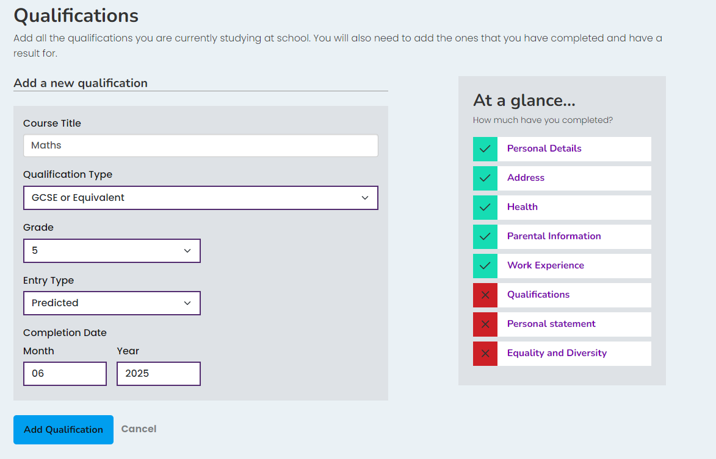
Tips On Adding Your Qualifications
Add entry for each GCSE subject
Add predicted grade/mock result
Change Year to 2025
You can come back later to add
Make sure you add before applying!
Notes:
You need to add a separate entry for each subject.
Enter your predicted grade (usually 1 to 9) or the last grade you got for your mock exams.
Leave Predicted as the entry type but change the year to 2025
If you are not sure of your grades, you can come back later and add these but make sure you do this before you go on to apply.

Slide 20
What is a Personal Statement?
Gives others an insight what inspires you
Highlights your skills and experiences
Strengthens any applications
Notes:
A personal statement gives others an insight into what motivates or inspires you. It can highlight your skills and experiences and can strengthen your application. It's your chance to talk about what interests you, any career goals you may have, what you’re good at or your favourite subjects at school?

Slide 21
Why Is It Good To Write One?
Your chance to make a great first impression!
How your strengths and skills link to career choices
Good practice for any future uni or job applications
Notes:
Adding your statement on KentChoices is your chance to make a great first impression and gives the school or college where you are applying to a good idea of what you are like as a person, rather than just listing your academic abilities.
It can get you thinking about how your strengths and skills link in with your career choices and is good practice for future university or job applications.

Slide 22
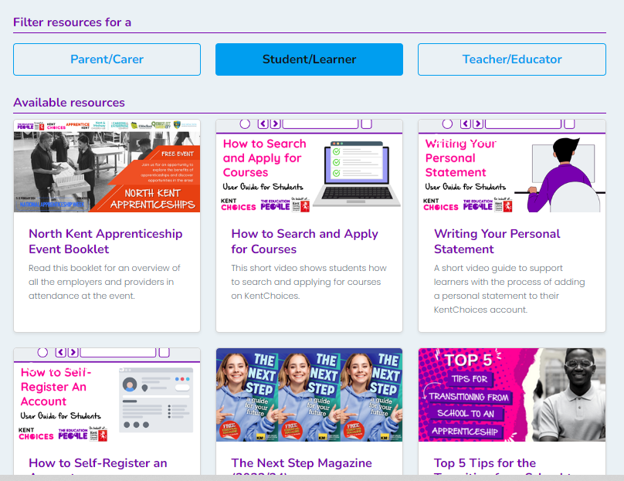
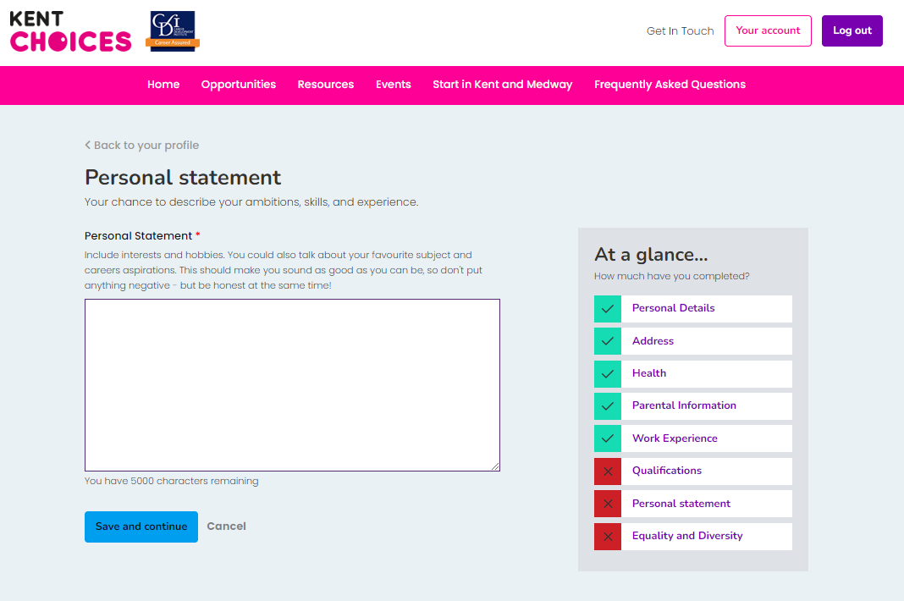



Not Sure What To Write??
Notes:
If you’re not sure what to write about here, you can watch a short video with useful tips in Resources** Your school may be planning a workshop on writing personal statements.

Slide 23
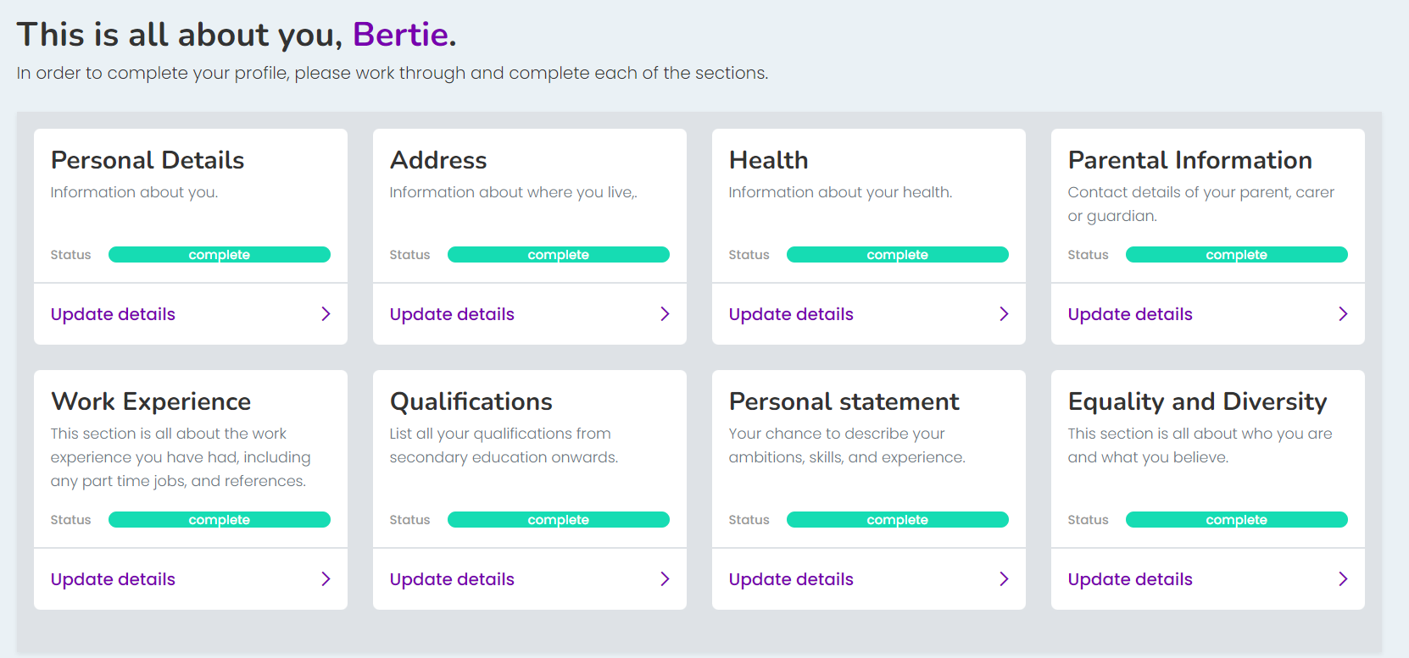
All Done - Great Job!
Notes:
Great job! You’re all ready to start searching now and apply when you’re in Year 11.

Slide 24
What Can I Do Now?
Find out about the options available
Check you’ve added your correct tel no and email
Search for courses
Search for open events
Notes:
Have you added your correct contact details. Go to Personal Details to double check.

Slide 25
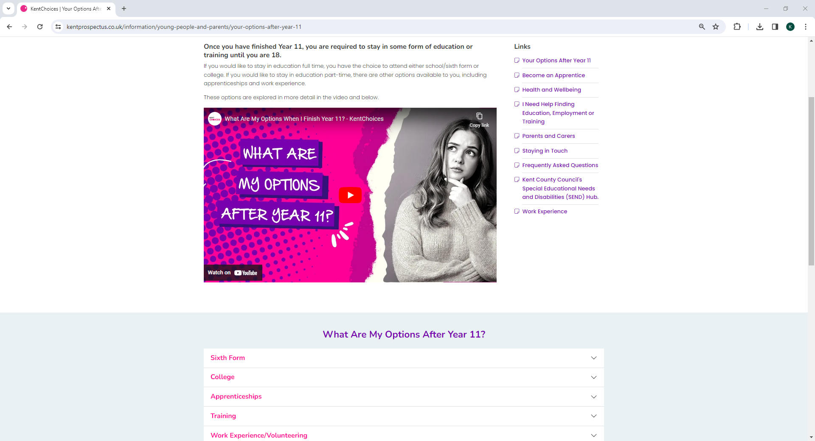
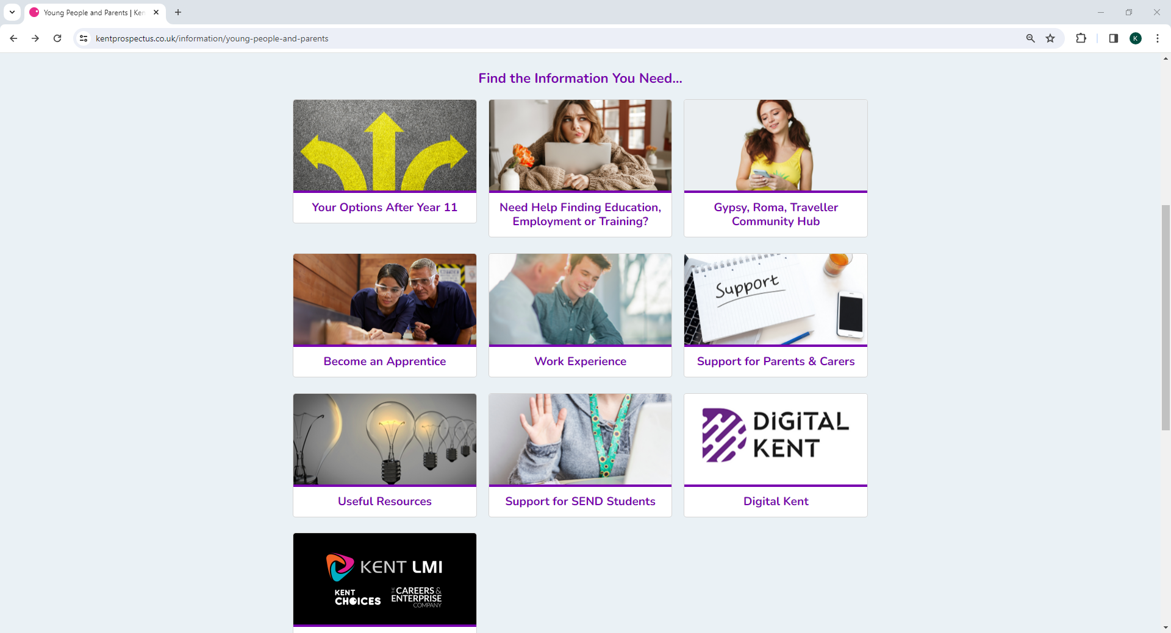
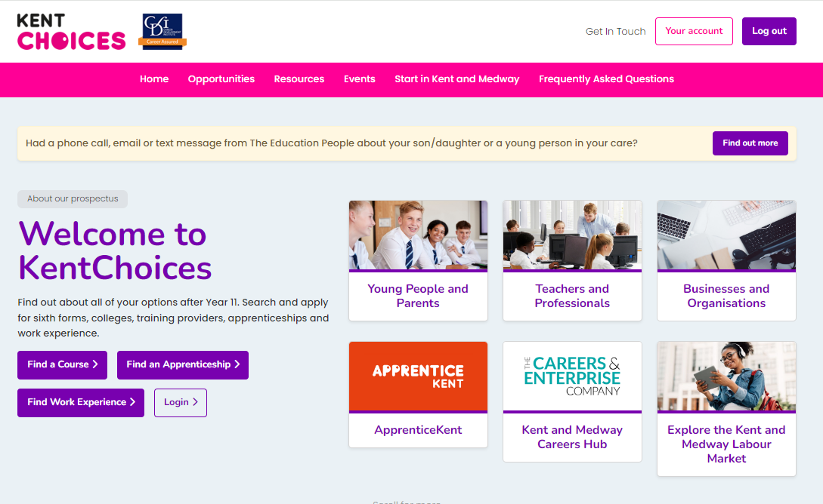
Your Options
Notes:
Click on Young People and Parents*, then Your Options After Year 11*. To find out what your options are*

Slide 26
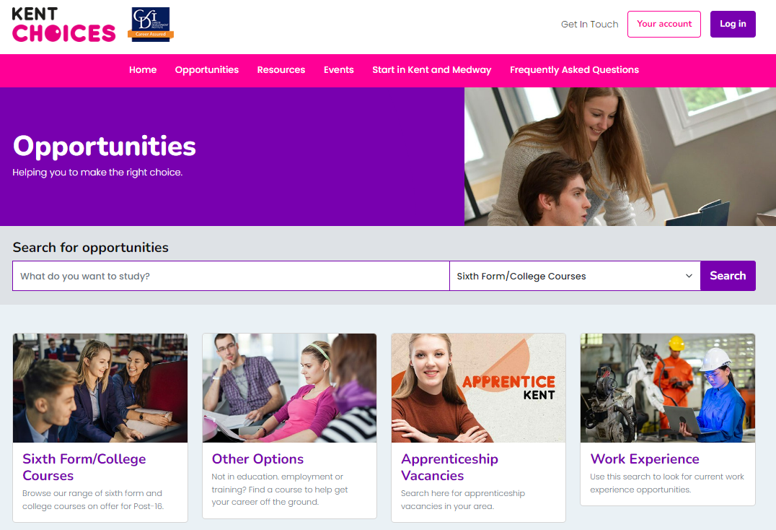
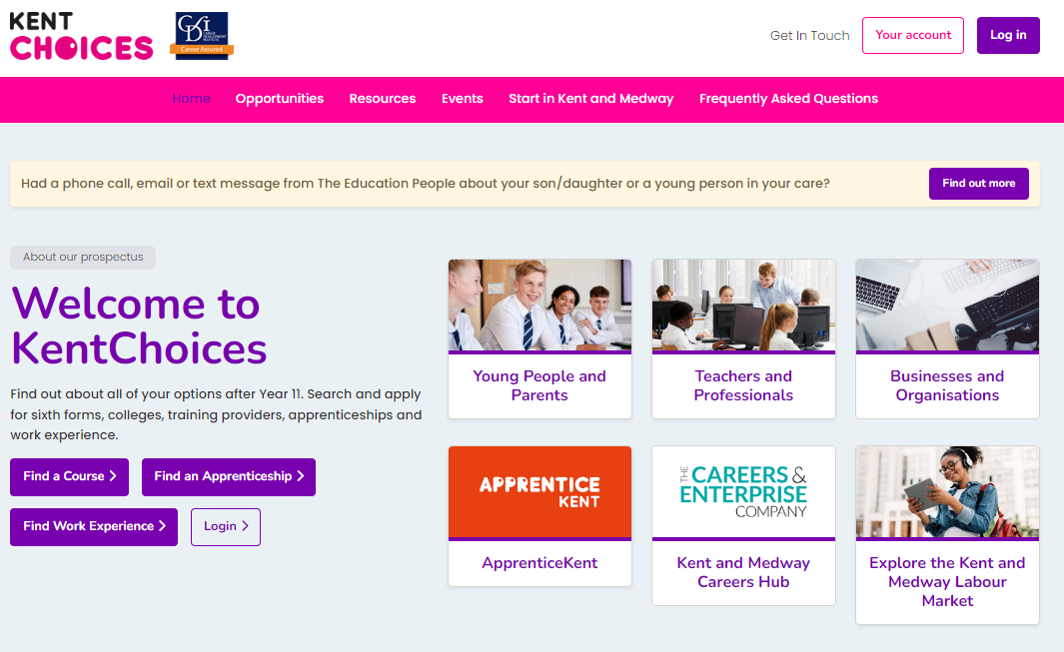

Searching
Notes:
To search for sixth form or college courses, click Find a course*.
If you have an idea of what you’d like to study, type this in the search bar*. If you're not sure, you can leave this blank. Then click Search*.

Slide 27
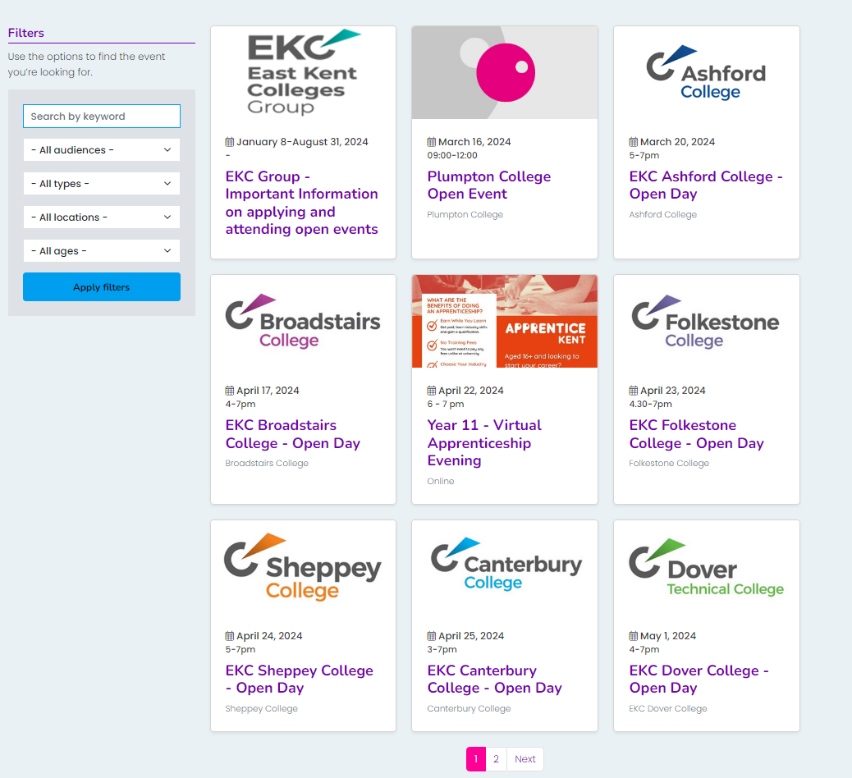
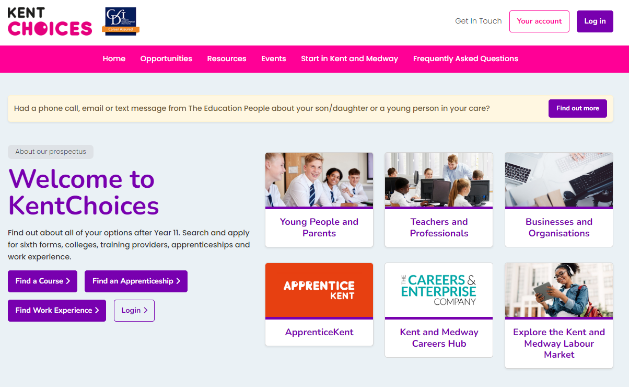
Upcoming Events
Notes:
To find out about upcoming open events, click on Events*. You can use the filters* to narrow your results. Click on the event* to find out more information.

Slide 28
When You’re In Year 11
Logon onto your account to review and update info
Check for open events
Search / favourite courses
Apply and track your applications (after 1 Nov 2024)
Notes:
When you’re in Year 11, you’ll be able to log back onto your KentChoices account, update your information and start searching and applying.

Slide 29
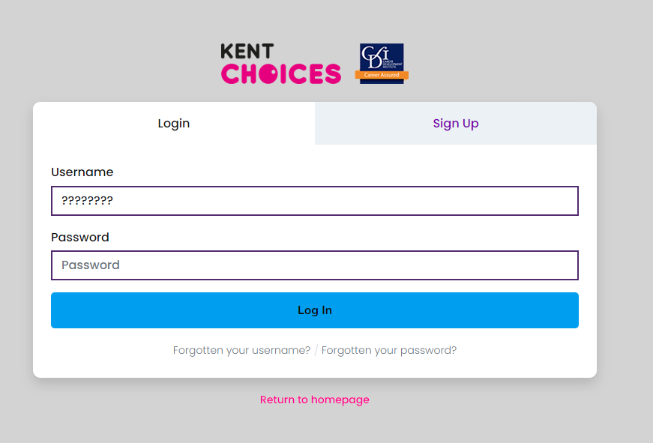
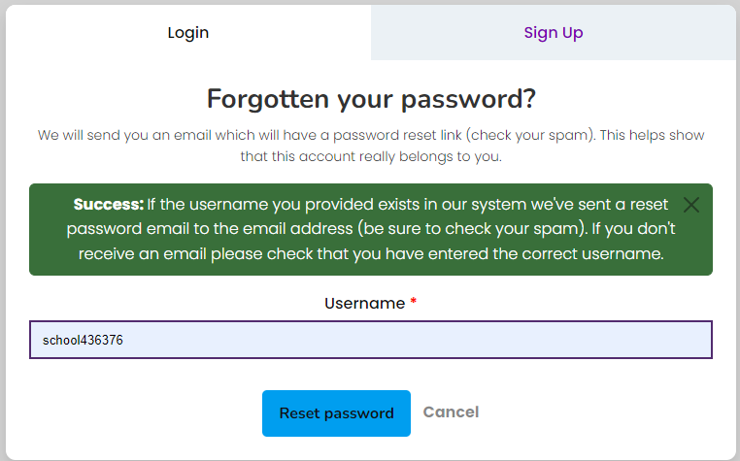
Forgotten Your Details?
Notes:
Don’t worry if you’ve forgotten your login; as you have your contact details registered to your account now you can quickly retrieve them if needed**!

Slide 30

Any Questions???
Notes:
Any questions?

Slide 31
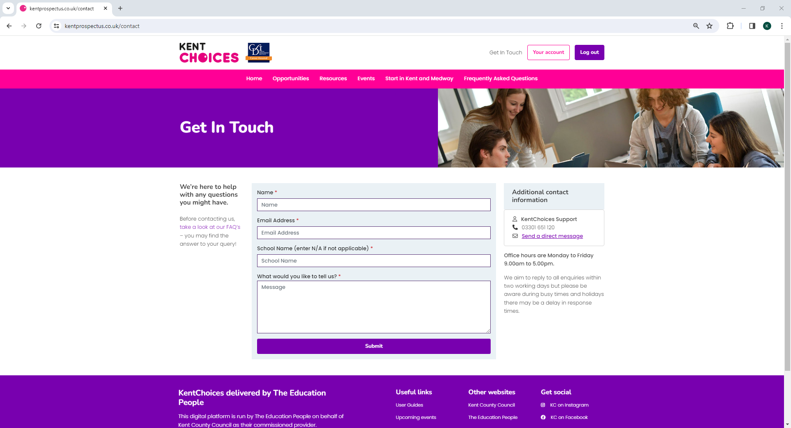
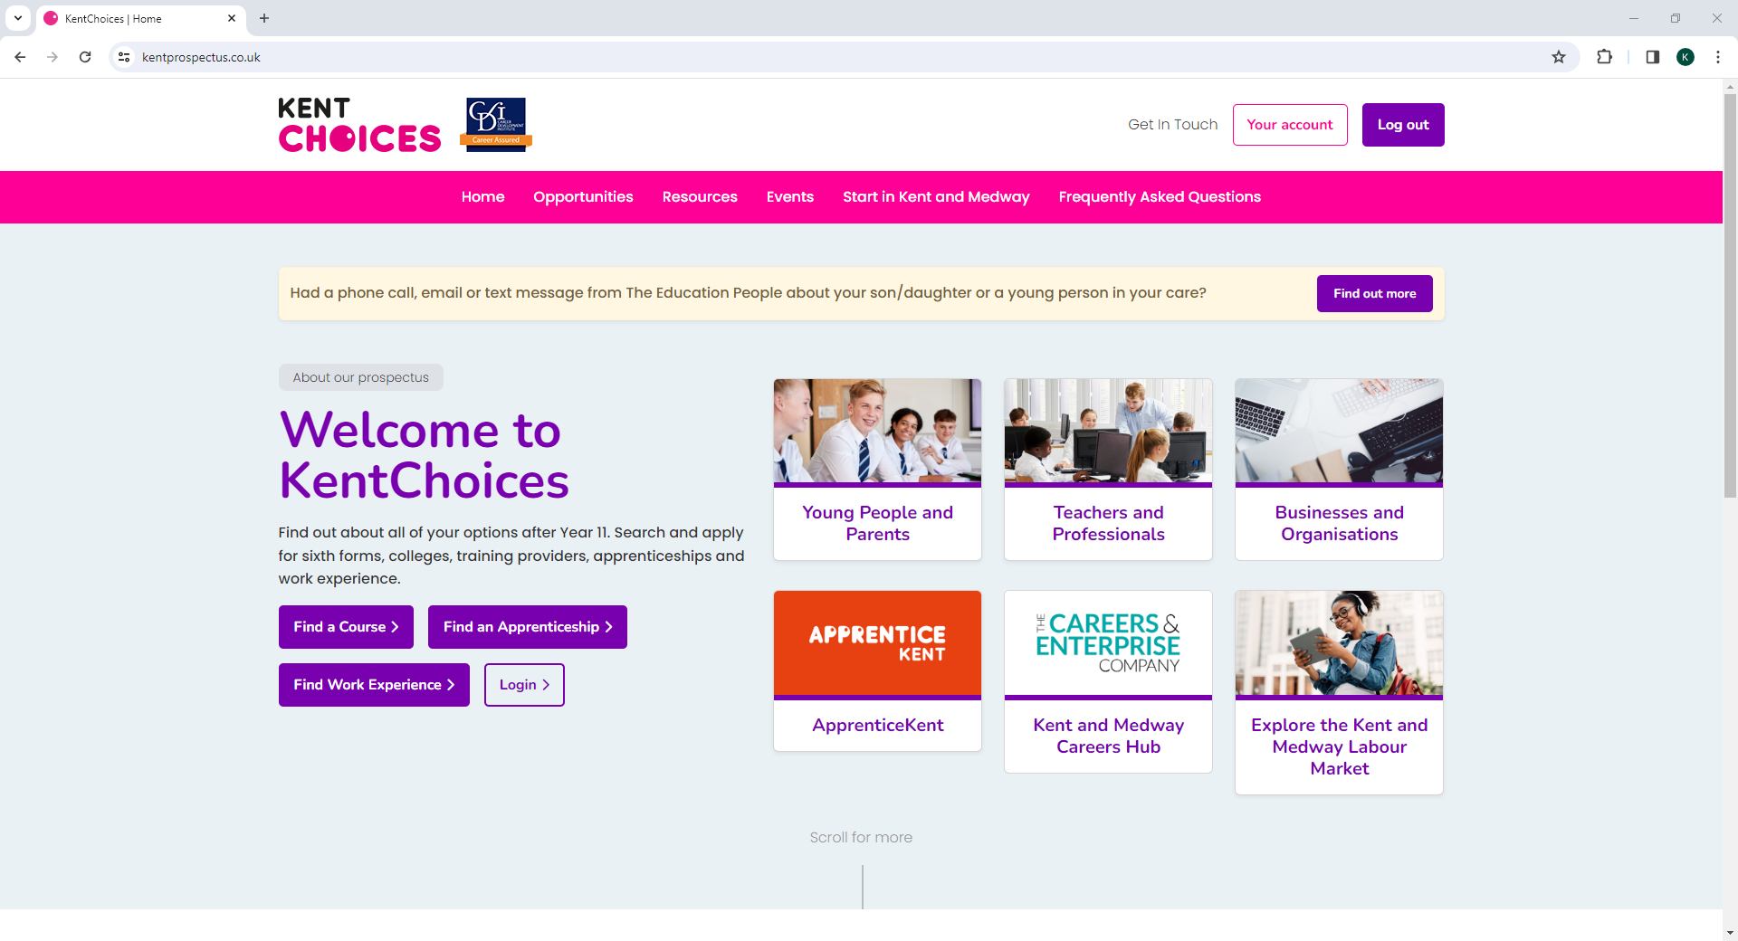
Contact KentChoices
Notes:
If you have any queries, please contact the KentChoices team. Find contact details by clicking Get in Touch.

Slide 32




Comments or Feedback
KentChoices@theeducationpeople.org
Notes:
Teachers and tutors, if you or your learners have any comments and feedback on KentChoices or this lesson plan – we’d love to hear them. Contact us at KentChoices@theeducationpeople.org.

Slide 33
Thank you
The KentChoices Team
The Education People working in partnership with Kent County Council

