Slide 1


Changes to the KentChoices Timeline
18th, 22nd, 24th and 30th April 2024

Slide 2


How Many Young People Have Used KentChoices So Far This Year?
New Users
New user visits to KentChoices up from 100,136 to 132,659.
Year 11s Logged In
Year 11 learners logged on to KentChoices up from 12,656 (71% of cohort) to 13,081 (73%)
Year 11 Applications
Year 11 learners applied through KentChoices up from 9851 (55% of cohort) to 10,716 (60%)
4
Self-Registered Learners
Number of learners self-registered with EKC 1588

Slide 3

Agenda
What changes are being made?
Benefits to schools and learners
What do I need to do?

Slide 4

What Are We Doing?
Making learners’ usernames and passwords available to schools at the beginning of term 6 in Year 10.
Encouraging as many schools as possible to use term 6 in Year 10 to get learners to access their accounts for the first time.
They:
will be able to add their personal details, update their username and passwords, create their profiles and look at the type of options that will be available to them after Year 11.
won’t be able to make any applications until they are in Year 11.

Slide 5
What We Are NOT Asking Schools to Do
Update Sixth Form Offer Early for 2025/26
The deadline will remain 1st November.
Start Receiving Applications
Unless they choose to do so, the default date when applications will be opened will remain 1st November.
Hand Out Logins in Year 10
If it may be problematic to issue login details early this year, it is beneficial but not essential.

Slide 6
Why Are We Doing This?
To allow learners to better prepared for the decision making around post 16 transition.
More Time to Decide
They will be introduced to the concept of what to do after Year 11 earlier, so will have more time to make better decisions.
Dedicate Time for Each Part of the Application Process
The process of logging on/setting up their profiles and considering their post 16 options will be separated, so learners can have dedicated time to explore ‘what to do next’.

Slide 7

Case Study
“The big win for us was we used the KentChoices process as part of a series of ‘Future Ready’ sessions with our Y10 cohort last summer. Each group as part of their PSHE did a focus session on work experience (which was coming in July), next steps and then of course what KentChoices was and logins/account completion.
It meant we had a real head start come the autumn with students already having a good awareness of what the application process will look like. There wasn't really an exact science to it, just a few sessions which ignited the post-16 conversation at the tail end of Y10.”
Nigel Knight, Hartsdown Academy

Slide 8
Why Are We Doing This?
To ease the pressure on schools during the October/November pinch point.
Save Time
Schools will not have to get learners to log on or check their cohort, it will already be done.
Time can be spent focusing on updating the 2025/26 offer on KentChoices and setting it up to receive applications.
More opportunity for training on time saving functionality.

Slide 9
Case Study
“As Careers Advisers we all live busy lives and the beginning of Term 1 I find is always very hectic. Over the past couple of years, we made the decision to ask for the students username and passwords to be accessible earlier. We found by receiving these in Term 6 when things do tend to quieten down it gave us time to print out the username and password lists to be able to check for school leavers and school starters and get them added or removed as necessary.
This meant that during Term 6 we could use a character ed lesson for students to unlock their accounts without having the normal problems of some students not having their usernames and passwords. We get students to take a photograph of their slips during the lesson so they have a copy in case they lose their slip. We then hold an assembly just giving the basic information on how to complete their profiles, which we then send to parents asking them to help their child complete this during the summer holidays.
We find that pressure is off at the beginning of term 1 and gives us more time to cover important things like searching for courses, writing personal statements and completing applications. We find that breaking this down over the two terms means that we have better engagement from students as they don't get bored so quickly.”
Amanda Seymour, The Sittingbourne School

Slide 10

Why Are We Doing This?
To align the KentChoices timeline with other Kent applications processes e.g. phased transfer
To spread good practice across the county.

Slide 11
Case Study
“We run a Kent Choices workshop at the end of Year 10, where the website is introduced to the students. We give them their usernames and passwords, and as part of the workshop we get them to create their profile.
The benefits are that there is less pressure on curriculum time at this time of the year, we would have a lot of opposition from staff if we asked to take students out of lessons in October/November of Year 11.
This is the first time that most students are being asked to complete an 'application' and it provides the opportunity to explain how digital applications work, the importance of including all the mandatory information and why some information is optional. We also insist on students being 'professional', in other words using correct grammar and not using 'text speak', e.g. the use of capital letters!”
Alyson Shaw – Careers/WEX Co-Ordinator, Marsh Academy

Slide 12

East Kent College Group Areas
The East Kent College group now use the same software as KentChoices, the benefits for schools are:
It is a much simpler process to apply to college and for schools to explain to learners
If learners use their KentChoices accounts schools can see all their application data; simplifying September Guarantee/onward destination tracking
NB If learners don’t use their KentChoices account and create a college account, schools will not be able to track their applications.

Slide 13


We have been doing this for years now and find it really helpful…. All in all, we find this has been very successful. The only problem we have with some students is the ones who apply directly to the college but this has been much improved this year due to the colleges wanting them to apply through KentChoices.
Vivienne Sadler,
St. George's Church of England School

Slide 14
What if Learners Forget Their Usernames and Password or Move School?
Password Reset
Contact Info
Whitelist
Changes of School
The forgotten functionality will be improved over the summer, reminders will be sent direct by text or email.
Learners will need to be reminded to include email and phone numbers in their profiles.
Schools may need to whitelist noreply@eprospectus.co.uk to receive email notifications.
Logins are created using the January school census – so if a learner moves school over the summer, the same problem will remain if they are handed out in Year 10 or Year 11.

Slide 15
Case Study
“Last year we opted to get our year 10s onto KentChoices near the end of term 6. Strategically this was an exceptionally valuable move. We managed to iron out most of the "technical issues" immediately, so all our students came back as year 11s prepared for the option process to start.
Having access to Kent Choices over the summer also gave a number of our more diligent students time to start work on personal statements and gave them some more motivation to have a more mature outlook on the final year.”
Matt Lowe, Longfield Academy

Slide 16

Short Notice
Schools may struggle to change their term 6, Year 10 plans.
We understand it is short notice and it may not be possible in all cases.

Slide 17
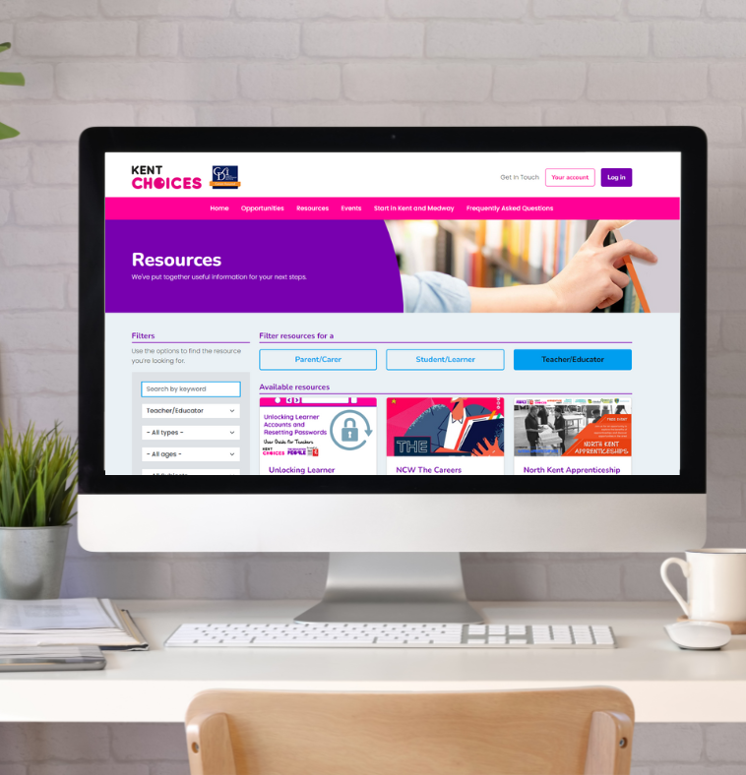
Resources to Support You
How to videos
- Checking your cohort
- Issuing login details (PDF)
- Issuing login details (Excel)
- Issuing login details (Email)
Lesson resources
- Short introduction to KentChoices
- Login Session for Year 10 Students
Ask your Engagement Officer if you can use your allocated time to support.

Slide 18
Next Steps
Whitelist Email
Talk to Us
Add noreply@eprospectus.co.uk
to your school’s whitelist to ensure learners can easily
reset usernames and passwords.
Contact the KentChoices Team if you are not certain how the process would work for your learners.
Plan/Implement
Plan and implement the issuing of learners’ logins in term 6, considering how it could link it to your broader careers programme and experience of the workplace activities.

Slide 19

To Conclude
You don’t have to do this but there are proven organisational and learning benefits.
In the East Kent areas – getting learners to use their KentChoices accounts (rather than a college generated account) will allow you to track all your learner’s applications.

Slide 20
Questions?

