Slide 1
Wednesday

Slide 2


What is a personal statement?
Definition:
A short piece of writing all about you – a chance to showcase your personality, skills, hobbies, interests and goals.
Purpose:
To provide a school/college more information, to support your application to their course – they want to know more than just your predicted grades!

Slide 3

Writing a Personal statement
Click here to watch: https://www.youtube.com/watch?v=F0GJCKjY9B8

Slide 4
Brainstorm:
What could you include in your personal statement?

Slide 5

What to include?
Introduce yourself
Favourite school subjects
Hobbies
Skills
Qualities
Interests
Goals
Future plans

Slide 6
Your Personal Statement Writing Guide:
To get you started...
I am a current Year 11 student at…
I would describe myself as…
I am really interested in…
Talking about school
One of my favourite subjects at school is… because…
For my GSCE subjects, I picked…
During (subject) we have recently studied…. and I enjoyed this because….
Talking about your hobbies
In my free time I enjoy….
Outside of school, I am part of a (sports) team…which has taught me
Through my hobbies I have developed…
Talking about your skills
One of my key strengths is…
I am a good (skill), for example…
My teachers would describe me as…
Talking about your achievements
An achievement I am proud of is…
A goal I have received achieved is…
I have been awarded…
Talking about your future
After completing this course, I hope to…
My ambition in life is….
I am interested in a career in…

Slide 7
Skills Word Bank
Determined | Patient | Resilient | Independent | Ambitious
Adaptable | Hard-working | Confident | Motivated | Kind
Supportive | Communicator | Organised | Reliable | Leader
Critical thinker | Focus | Creative | Problem Solver | Sporty

Slide 8
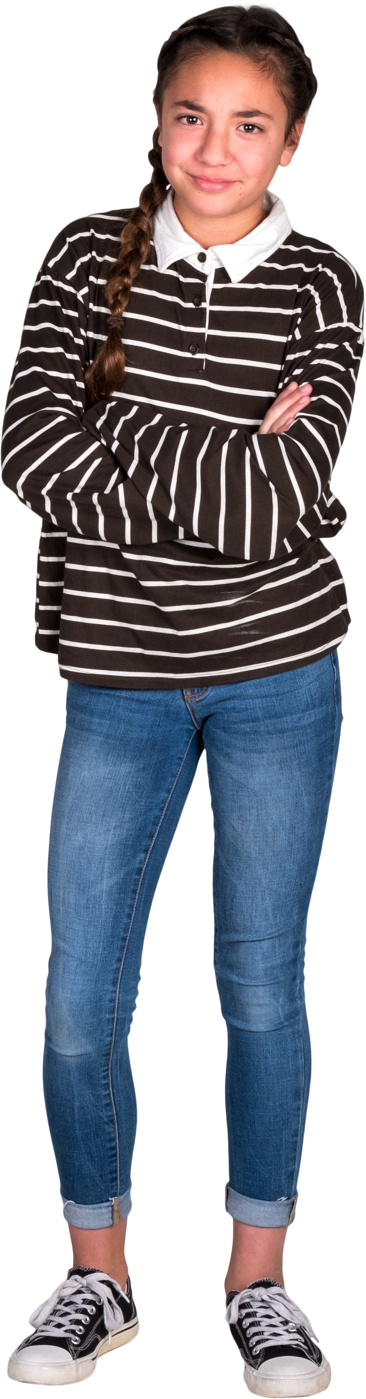
Example 1:
I am applying to sixth form because I would like the opportunity to continue my education and keep my options open. At school I have particularly enjoyed a range of subjects, especially English and Science, as they have helped me develop my thinking and communication skills.
Outside of school, I enjoy spending time with friends and keeping active, which has taught me the importance of balance and organisation.
I am proud of achieving good results in my recent assessments because they show the effort I put into my studies. One of my key strengths is that I am reliable and willing to work hard to improve.
I have chosen sixth form because I feel it will give me more time to decide what I want to do in the future. In the long term, I hope to explore different opportunities and find a pathway that suits my skills and interests.

Slide 9
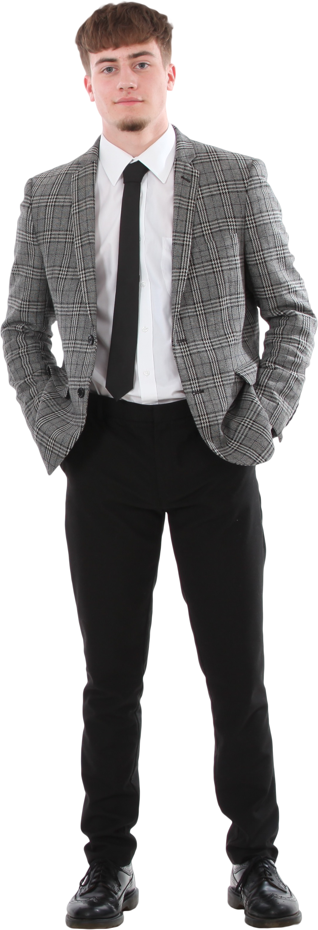
Example 2:
I am a current Year 11 student at Kent Choices School. At school I have particularly enjoyed PE because it allows me to challenge myself and work as part of a team. I also enjoy biology as I get to learn about the body, and how this could help in sports.
Outside of school, I play football for my local team which has helped me to develop my teamwork and leadership skills. I am proud of achieving ‘Player of the Season’ last year as it showed my commitment and hard work.
One of my key strengths is being determined and resilient, especially when training or competing.
I have chosen this course because I believe it will help me build the skills I need for a career in sports coaching. And in the future, I would like to progress into a sports-related career where I can continue to inspire and support others.

Slide 10





Top tips for your personal statement
Focus on your strengths
Highlight transferable skills
Express enthusiasm
Keep it concise
Ask someone to read through it

