Slide 1

Tuesday

Slide 2
Getting logged in

Slide 3
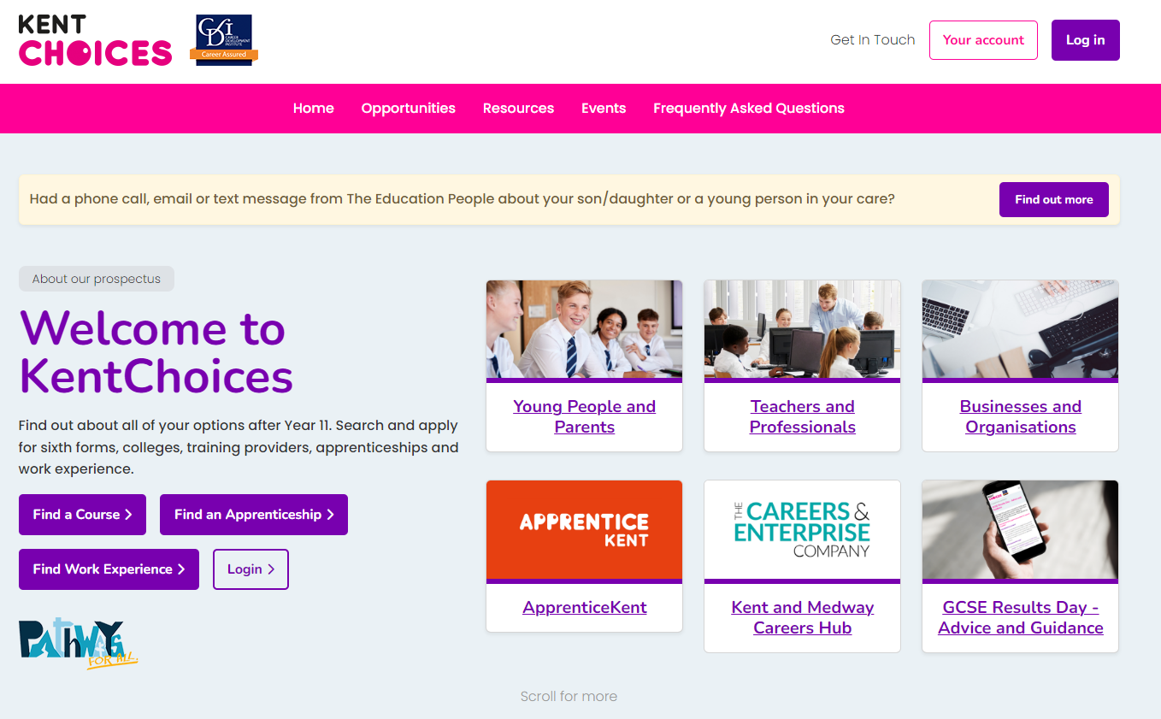

KentChoices.co.uk
Notes:
Go to KentChoices.co.uk and click Log in* to get started

Slide 4
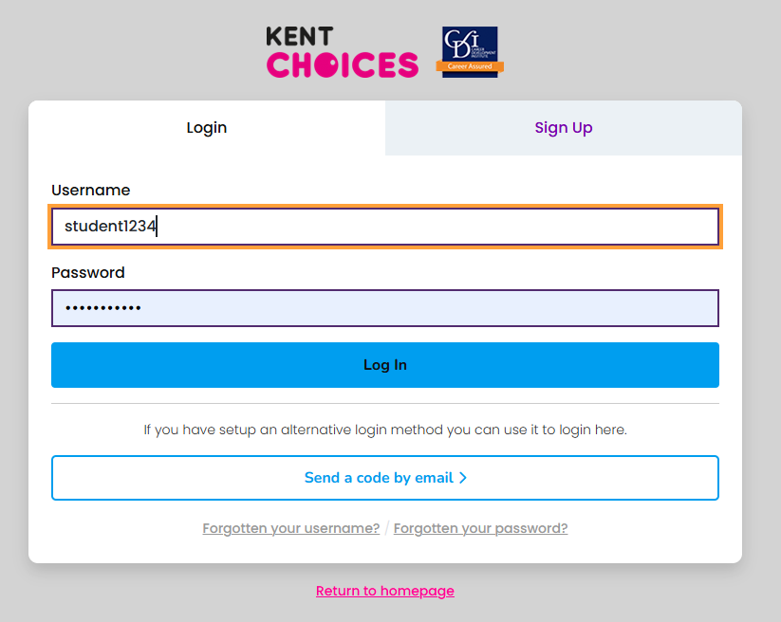
Log in

Slide 5
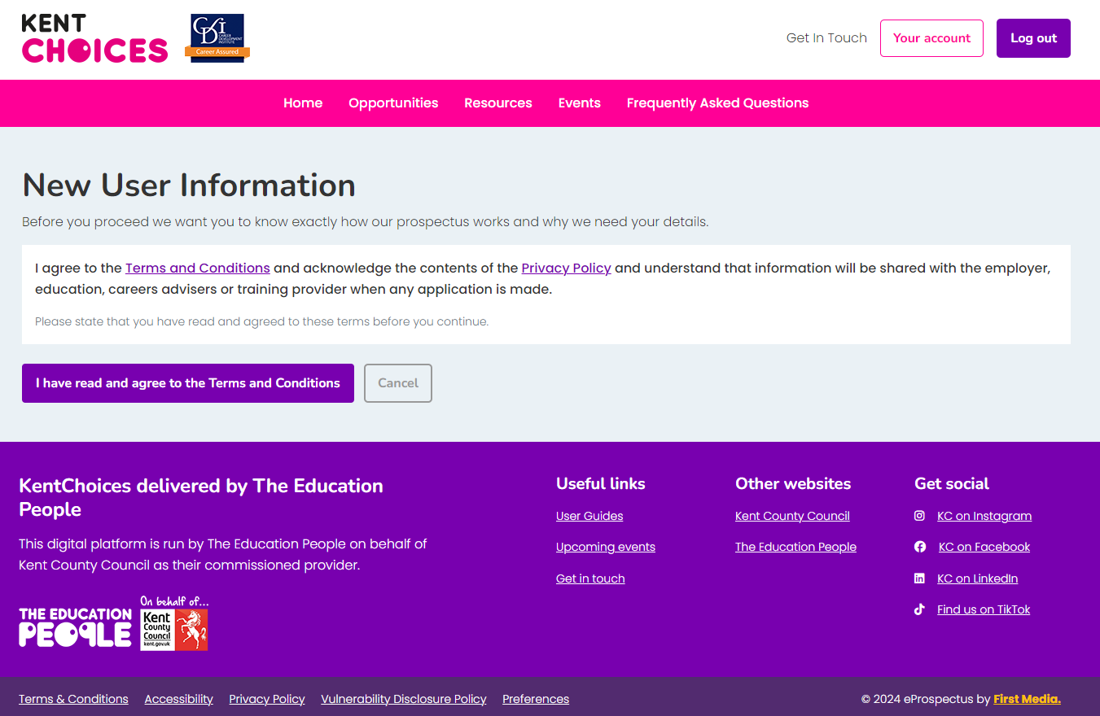
Agree to Terms and Conditions
Notes:
Agree to the terms and conditions.

Slide 6
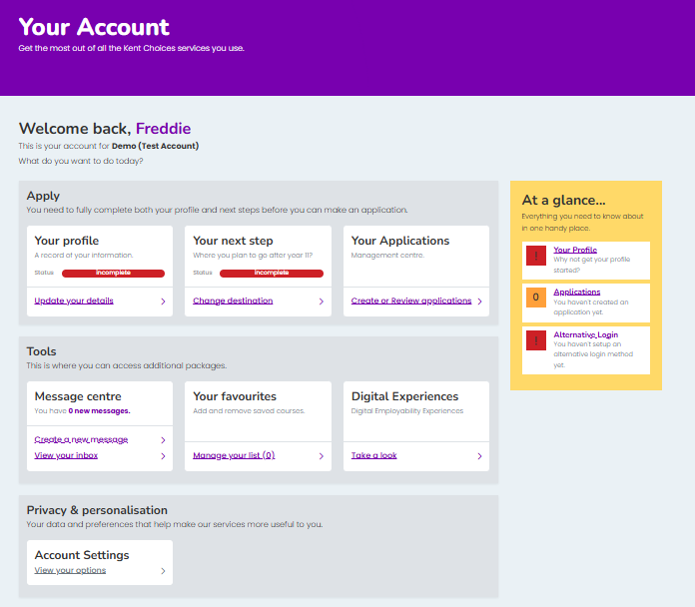
Your Account - Dashboard
Notes:
This is Your Account Dashboard

Slide 7
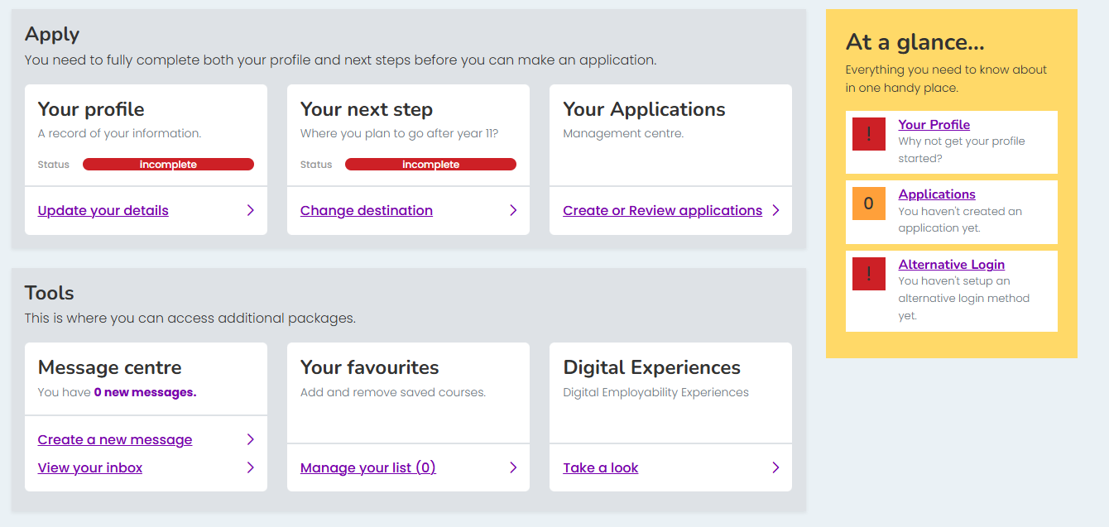

Alternative Login Set Up
Notes:
Let’s now set up an ‘alternative login’. This way you can easily access your account if you forget your username and password. Click Alternative Login

Slide 8
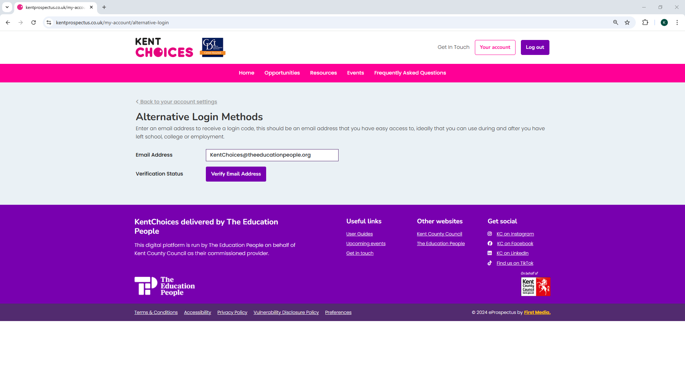
Notes:
Enter an email you have easy access to and click Verify

Slide 9
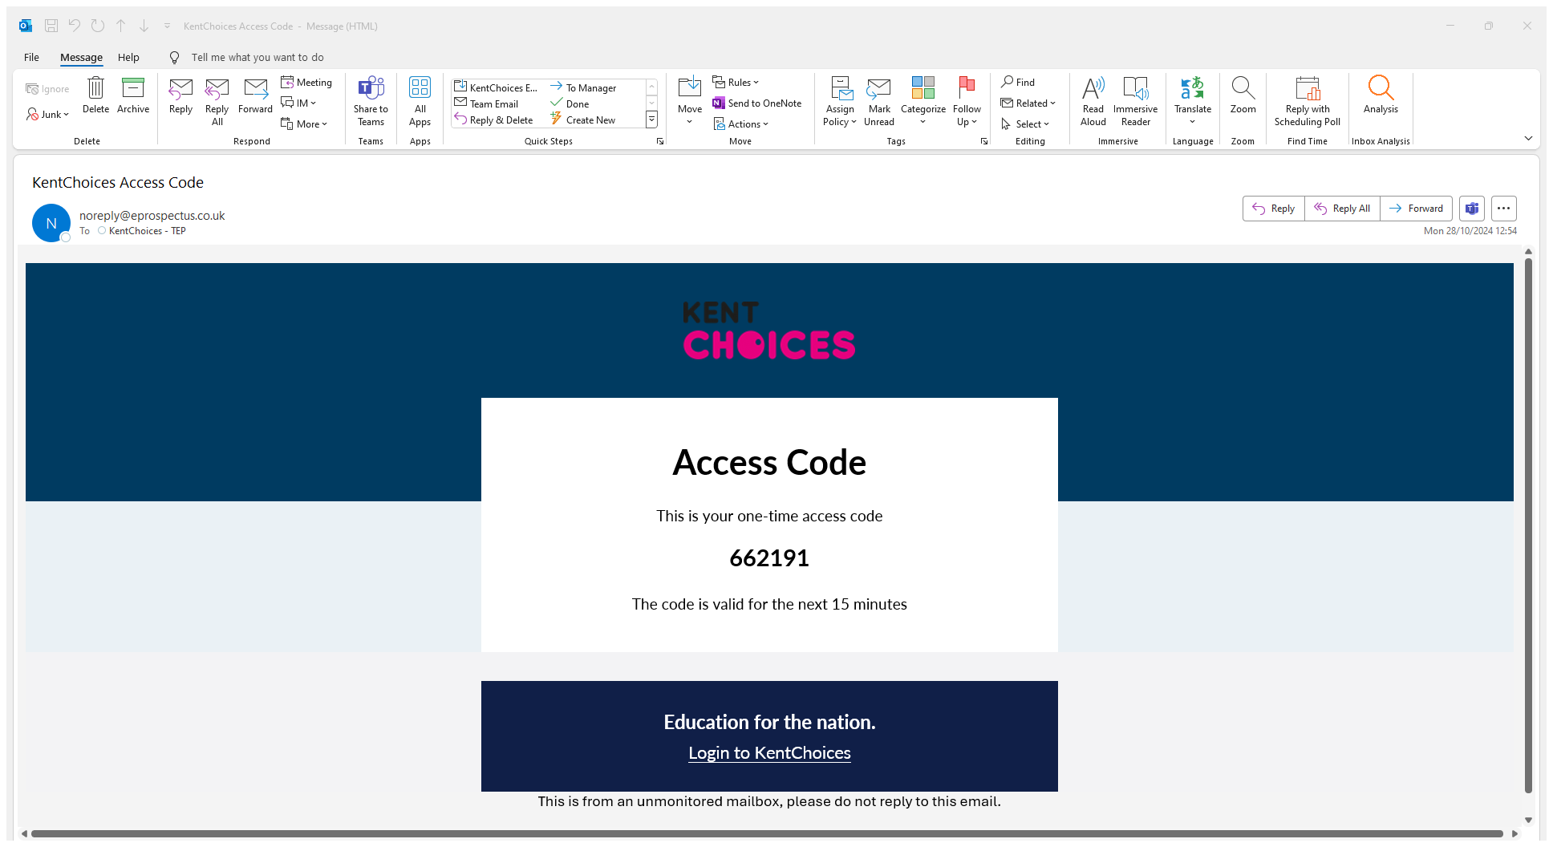
Notes:
Check your email for an access code

Slide 10
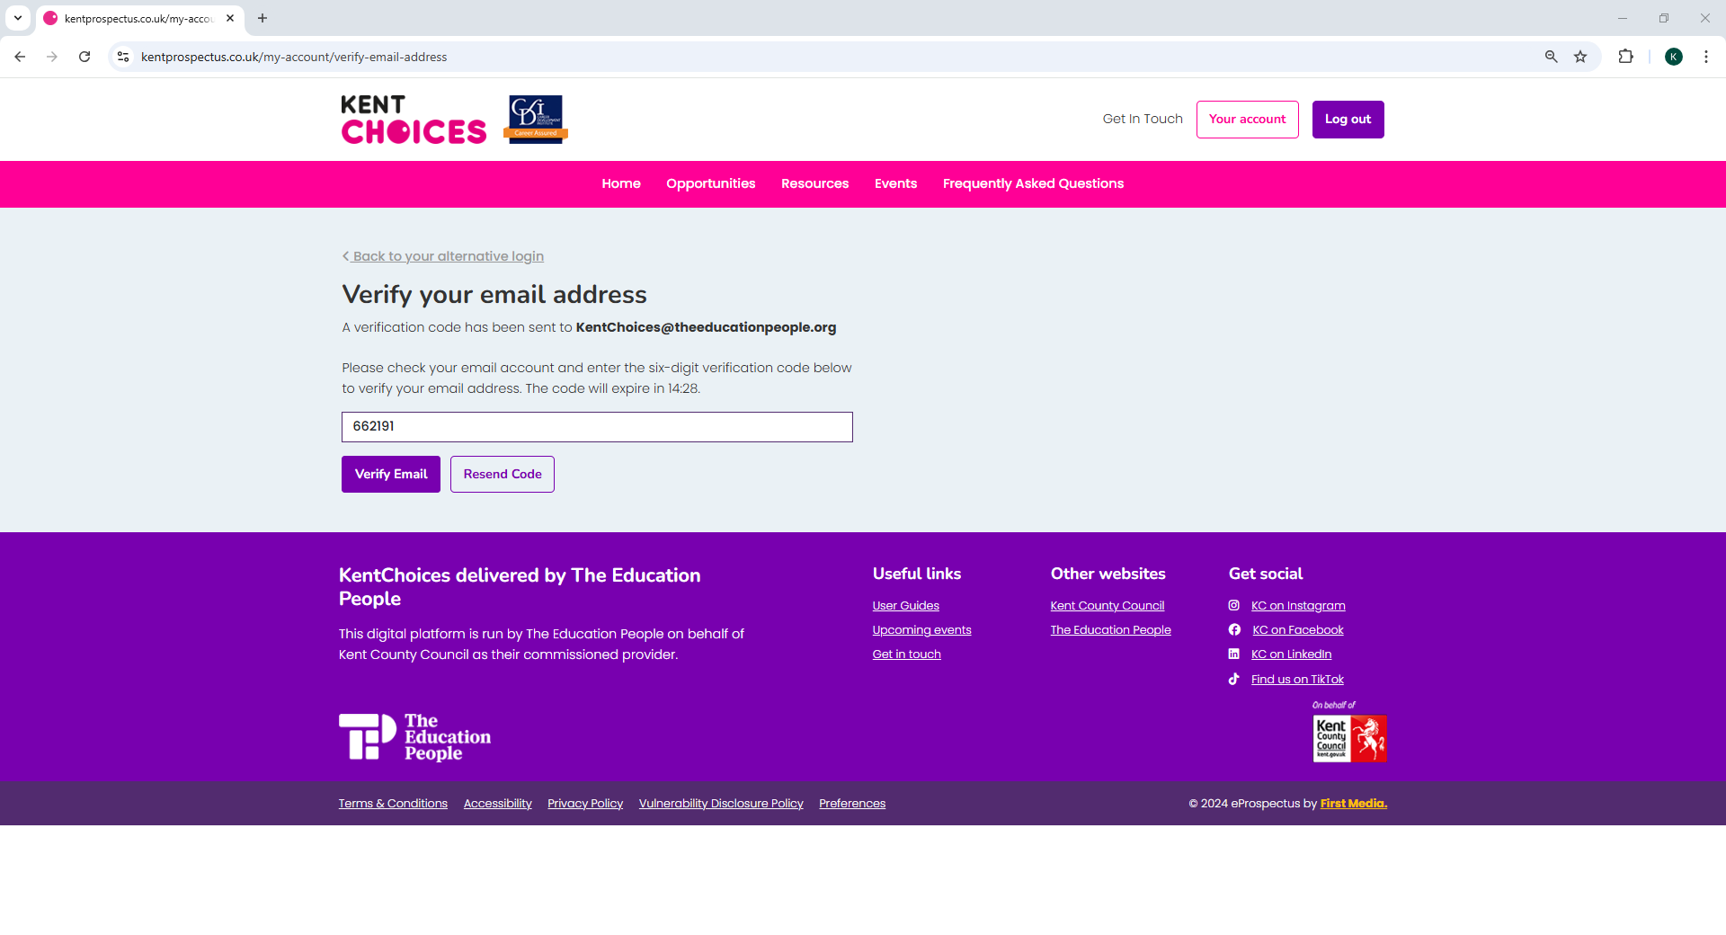
Notes:
Enter this code and click Verify Email

Slide 11
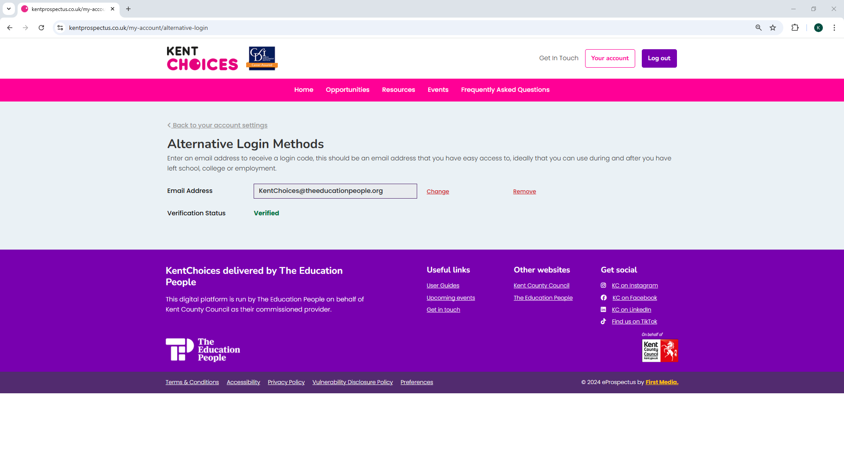
Notes:
Your alternative method is all now set up.

Slide 12
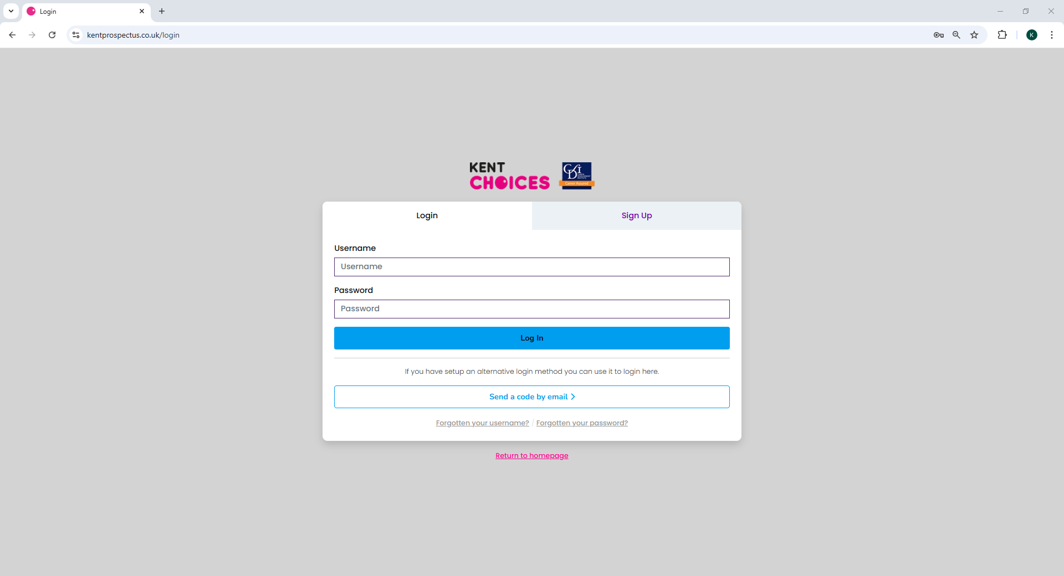
Notes:
You can now select this method to login with a one-time code instead of your username and password in the future.

Slide 13
Setting up your profile

Slide 14
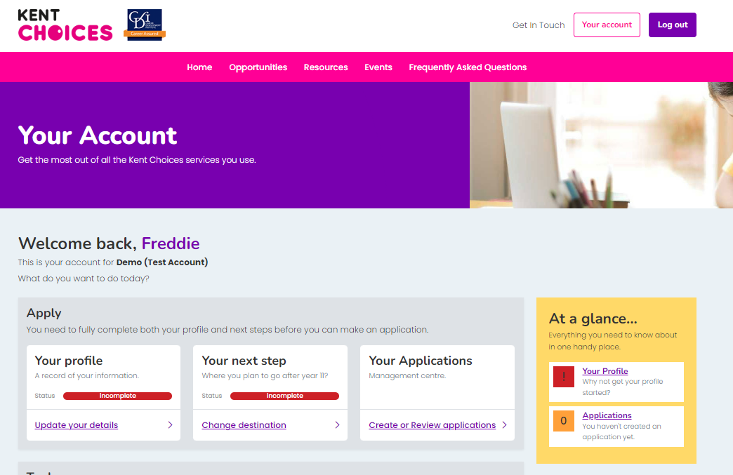


Your profile
Notes:
Click Your Account to take you back to your dashboard. Now let's update Your Profile.

Slide 15
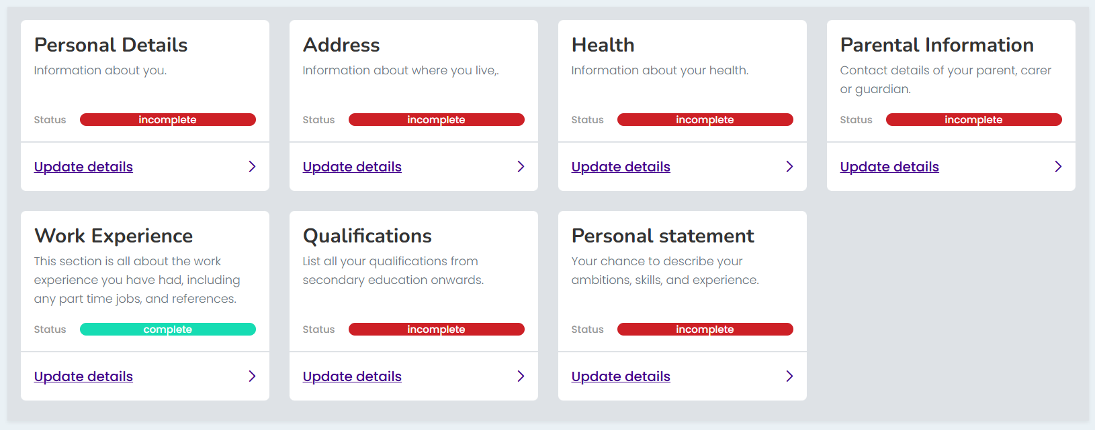


Complete your profile
Notes:
Work your way through each of the sections until they turn green***

Slide 16
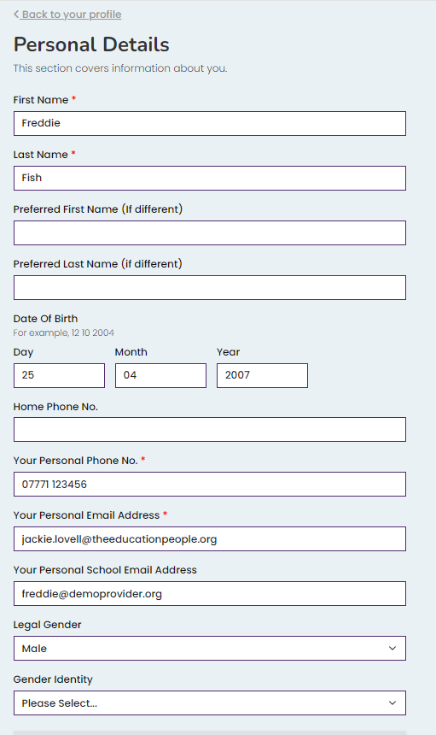
📱 Add your contact details 📧
*** IMPORTANT ***
Providers need to contact you!
Add a mobile number
Add at least one email address
Notes:
Make sure you add a telephone number and a personal or school email address, so sixth forms and colleges can contact you about your application.

Slide 17
Tips on completing your profile
📝 You need to complete all fields with a red *
📧 If you don’t know your parents email address,
add your own - you can update later
💼 Don’t forget to add any work experience!
Notes:
Here are a couple of top tips on completing your profile:
You need to complete all fields marked with a red asterisk
If you don’t know your parents email address you can enter your own for the time being – just remember to change this later.
Add any work experience you’ve done or if you are about to do.
Don’t worry if you can’t complete all the information, you can come back and update or add information later if you need to.

Slide 18
Keep it professional!
📧 Is your email address suitable?
🧾 Info helps schools/colleges make decisions
✏️ Check your spelling and grammar!
Notes:
Information you provide will be used to help sixth forms and colleges make a decision about your application so keep it professional and remember to check your spelling and grammar.

Slide 19
Tips on adding qualifications
🎓 Add an entry for each GCSE exam
🎯 Add your predicted grade or mock result
📆 Keep the Month 06 and Year 2026
Notes:
Tips on adding qualifications:
You need to add a separate entry for each GCSE exam you will be taking
Enter your predicted grade (usually 1 to 9) or the last grade you got for your mock exams.
Leave Predicted as the entry type but change the year to 2026
If you are not sure of your grades, you can come back later and add these but make sure you do this before you go on to apply.

Slide 20
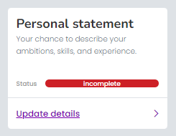
Leave the personal statement box blank for now…
In the next session, we cover writing your personal statement.

