Slide 1
Friday

Slide 2

Making an application
Click here to watch: https://www.youtube.com/watch?v=LwE_hp1fc34

Slide 3
Application Tips:
Make sure to check when applications open and importantly close – you don’t want to miss any deadlines!
Remember to keep your personal statement general – it will go to all of your applications
Always proofread your personal statement!
When applying to 6th Forms generally you need to select at least 3 courses, for colleges it’s typically one course
If applying to East Kent College, remember to select an applicant day.
We recommend a minimum of 2 max of 5 applications (on KentChoices the limit is 8)
You will need to put your applications in preference order, but you can change this at any point.

Slide 4
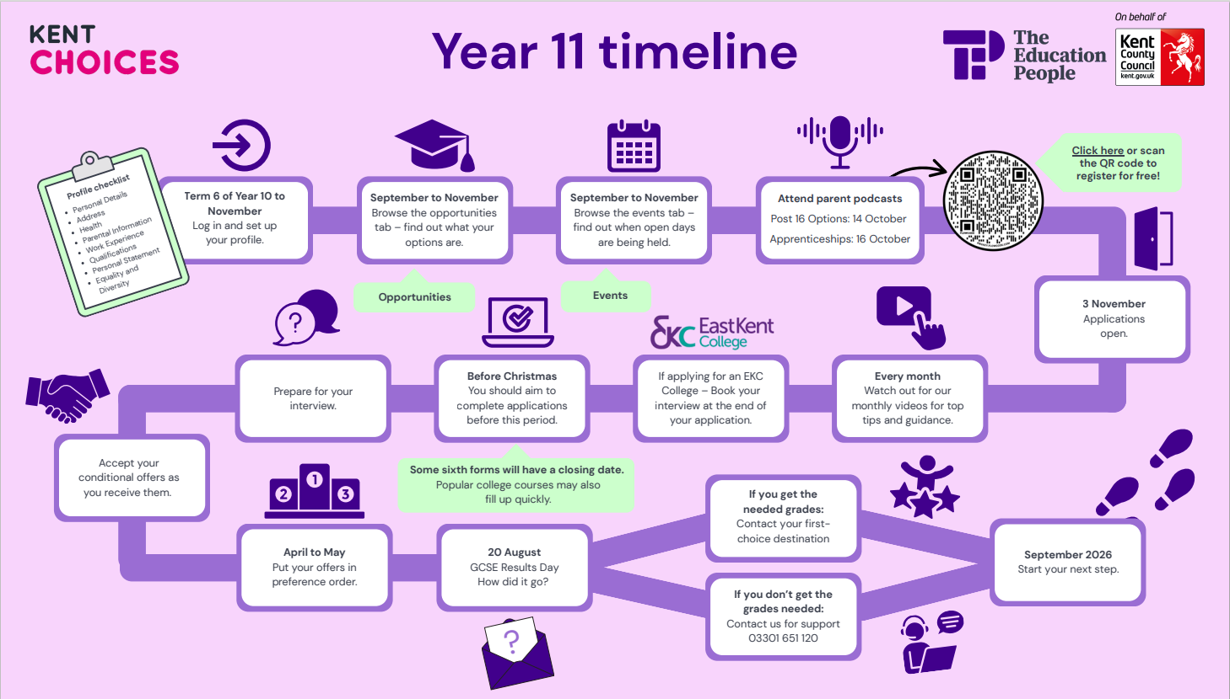

Slide 5
Next Steps:
Complete any unfinished areas of your profile.
Submit all your applications.
Book and attend your interviews.
Check your emails regularly for updates.
Accept your offers as you receive them.

Slide 6
For further support
KentChoices Team:
03301 651 120
Kentchoices@theeducationpeople.org

