Slide 1

KentChoices - Part 1: Introduction to KentChoices and Setting Up Your Profile

Slide 2


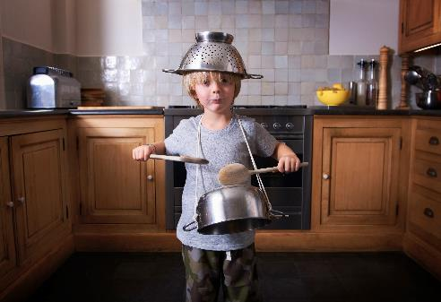






What did you want to be when you were younger?

Slide 3

Where do you want to be in five years time?
Now you need to work backwards

Slide 4

The options
Work with training
Sixth form
College
Training
Apprenticeships

Slide 5









The future
Things to consider
Familiar Environment
Subjects
Entry requirements
Learning Setting
Friends
Family
Pathways
Notes:
Brief overview of what will impact their choices

Slide 6

Sixth form

Slide 7
Sixth form
Familiar – your own school
Change - different school and some colleges
Multiple subjects – 2/3
Classroom based
Entry requirements – Generally grade 4/5s in Maths and English
Dress code – Formal
Choice of future pathways

Slide 8
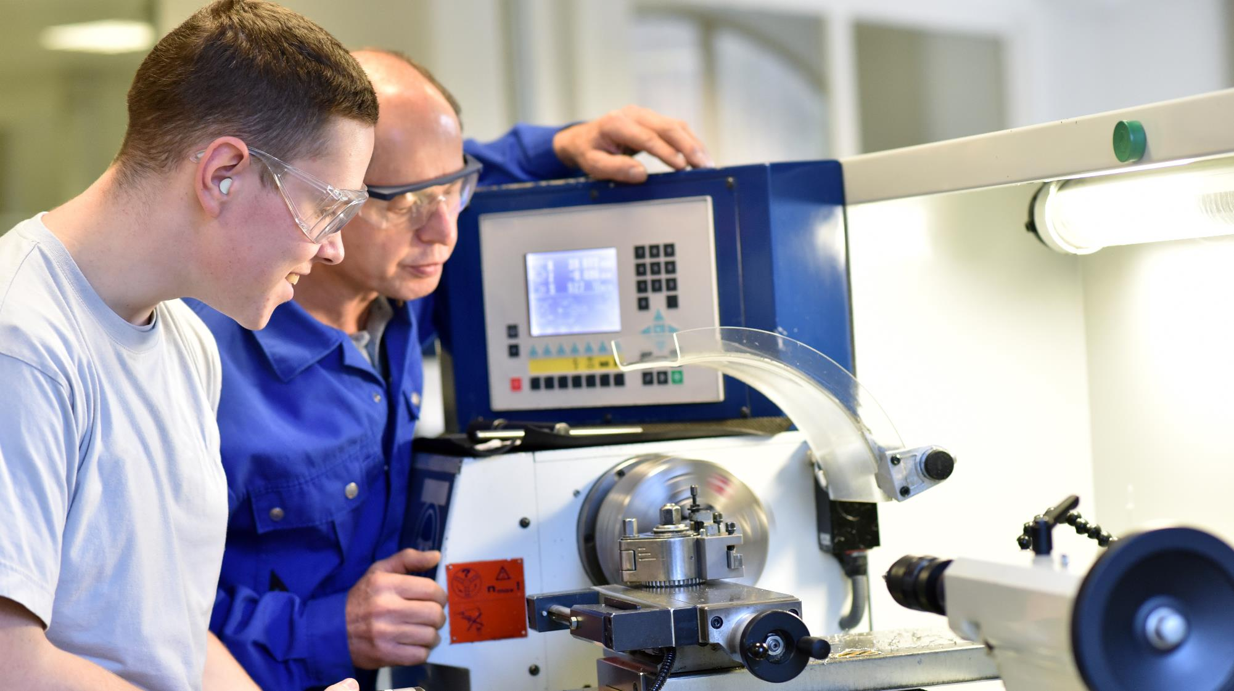

\
College

Slide 9
College
Change of environment
Vocational (some colleges also offer sixth form)
Timetable – 2/3 days a week
Entry requirements - Vary
Dress code – Course dependent
Choice of future pathways

Slide 10












Slide 11

Apprenticeships

Slide 12






“Earn and learn”
80%
20%
Paid employment
Training and study
Hands on
Recognised qualification
Age 16+

Slide 13




The training
One day a week (or equivalent) in formal training (20%).
Gain skills needed to complete the qualifications.
Theory learning and support with assignment work.
Practical training

Slide 14
The levels
Level 2
Level 3
Level 4/5/6/7
Intermediate
Equivalent to 5 GCSEs.
Entry Requirements vary.
You may not need grade 4 and above.
Advanced
Equivalent to two A Levels.
Entry Requirements vary.
You will need a grade 4 and above.
Higher/Degree
Equivalent to Foundation, Bachelors or Masters.
Entry requirements vary.

Slide 15

The money
Since April 2025, the minimum hourly wage is £7.55 an hour.
This is reviewed each year.

Slide 16
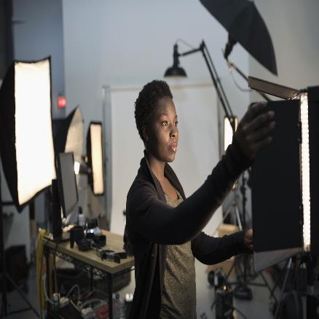


What else do you gain?
\\
Practical skills.
Professional mentors.
Recognised qualifications.

Slide 17
Training Providers

Slide 18
Training Providers
Smaller environments
Maths and English
Specialist focus
Work experience
Choice of future pathways

Slide 19














Lighthouse on The Marsh

Slide 20
Work with training
Can be put in place in a unique situation.
A combination of employment alongside formal training.
Hours of employment and training must meet the government guidelines.
Seek support from your careers lead for further information.

Slide 21
Discussion
(2 Minutes)
What are the positives and negatives of each option?
Will there be one ‘right’ path for everyone?
What do you need to consider to find the right path for you?

Slide 22


KentChoices

Slide 23




What is KentChoices?
Search
Apply
Events
Get Help

Slide 24
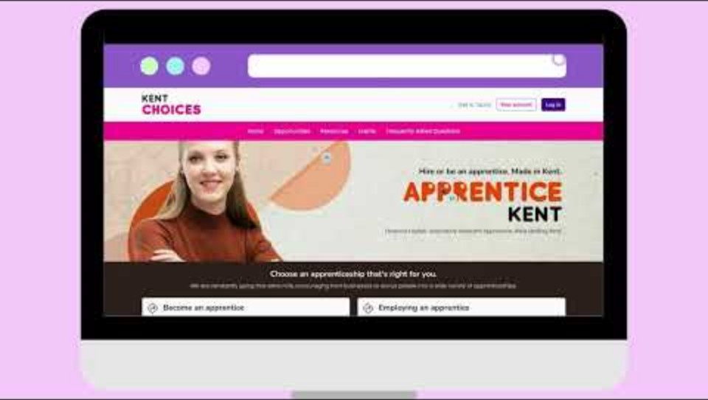
What is KentChoices?

Slide 25
Activity (10 Minutes)
🕵️‍♂️ Explore the website
🏫 Find local open events
🔎 Search for courses/check entry requirements

Slide 26
Getting logged in

Slide 27
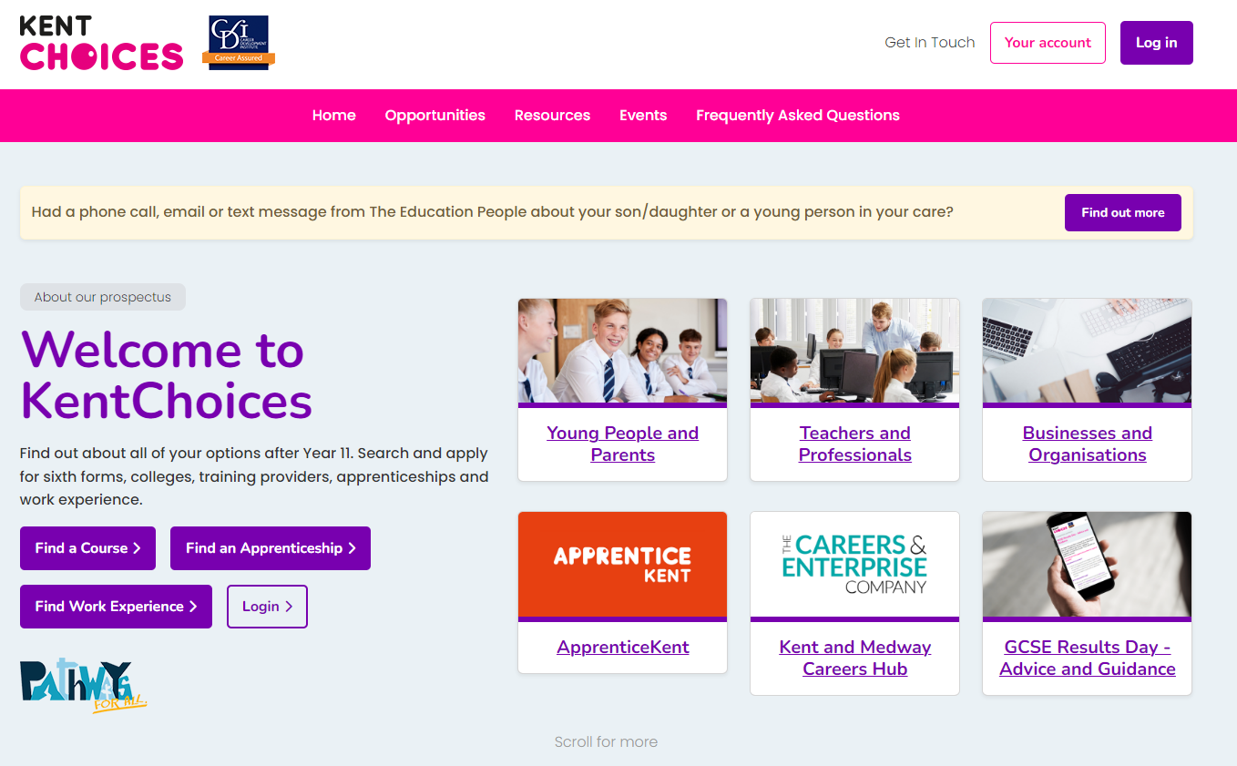

KentChoices.co.uk
Notes:
Go to KentChoices.co.uk and click Log in* to get started

Slide 28
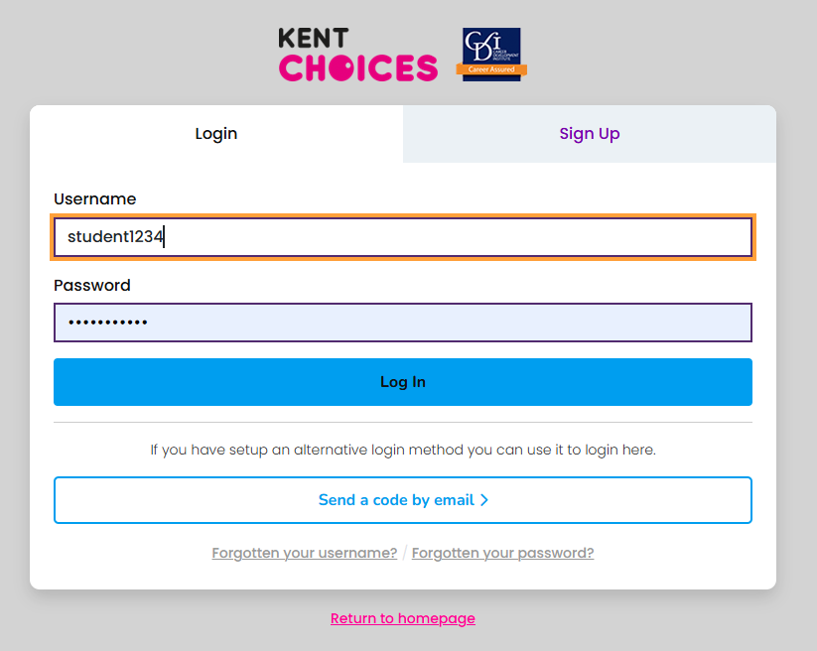
Log in

Slide 29
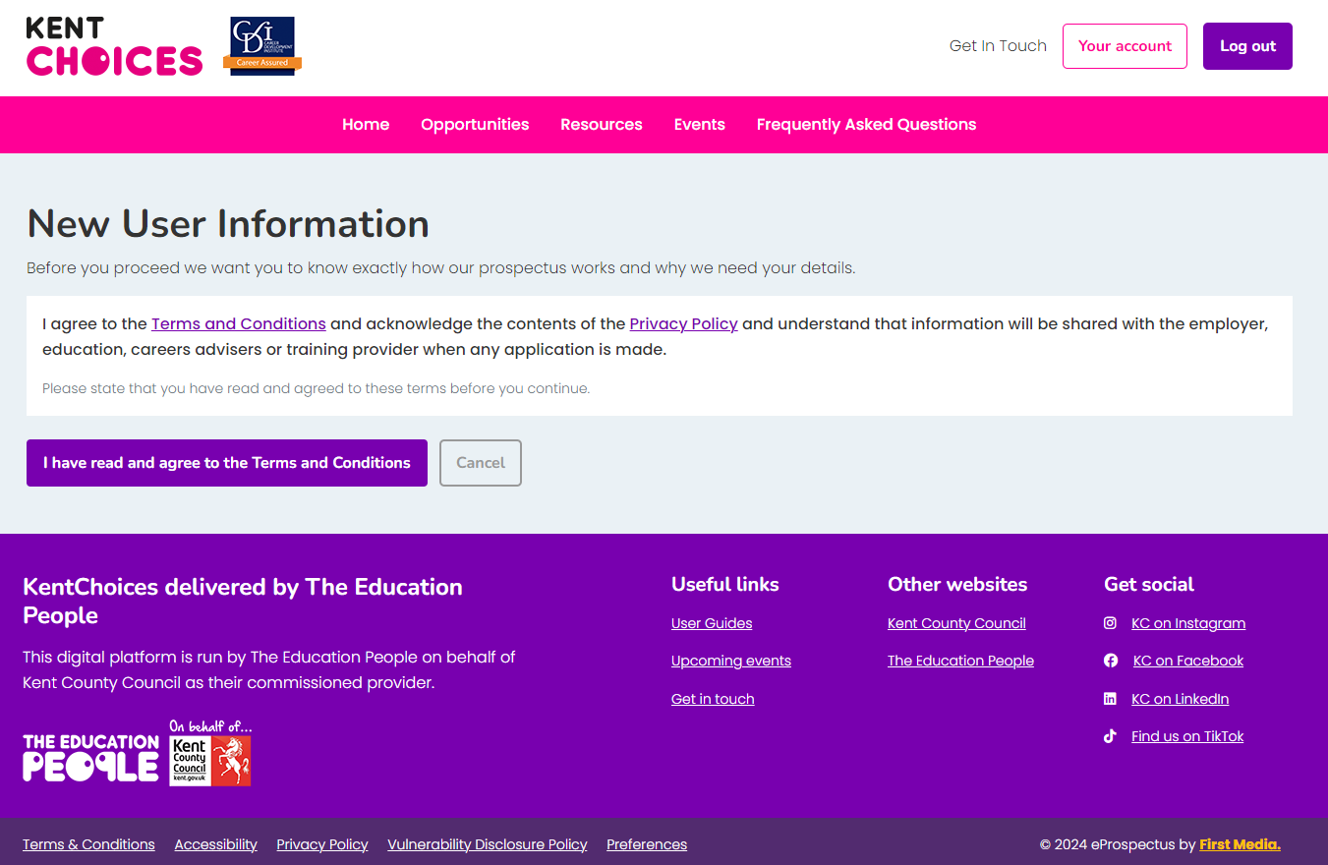
Agree to Terms and Conditions
Notes:
Agree to the terms and conditions.

Slide 30
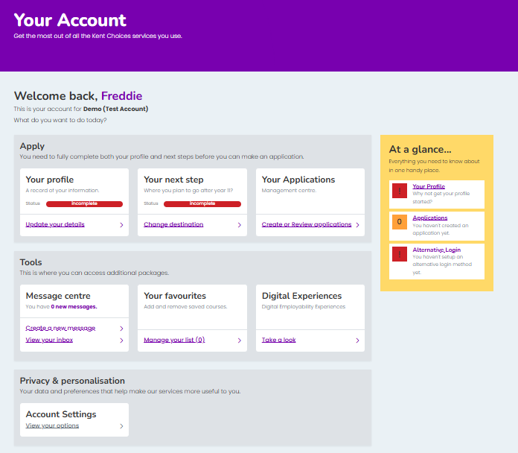
Your Account - Dashboard
Notes:
This is Your Account Dashboard

Slide 31
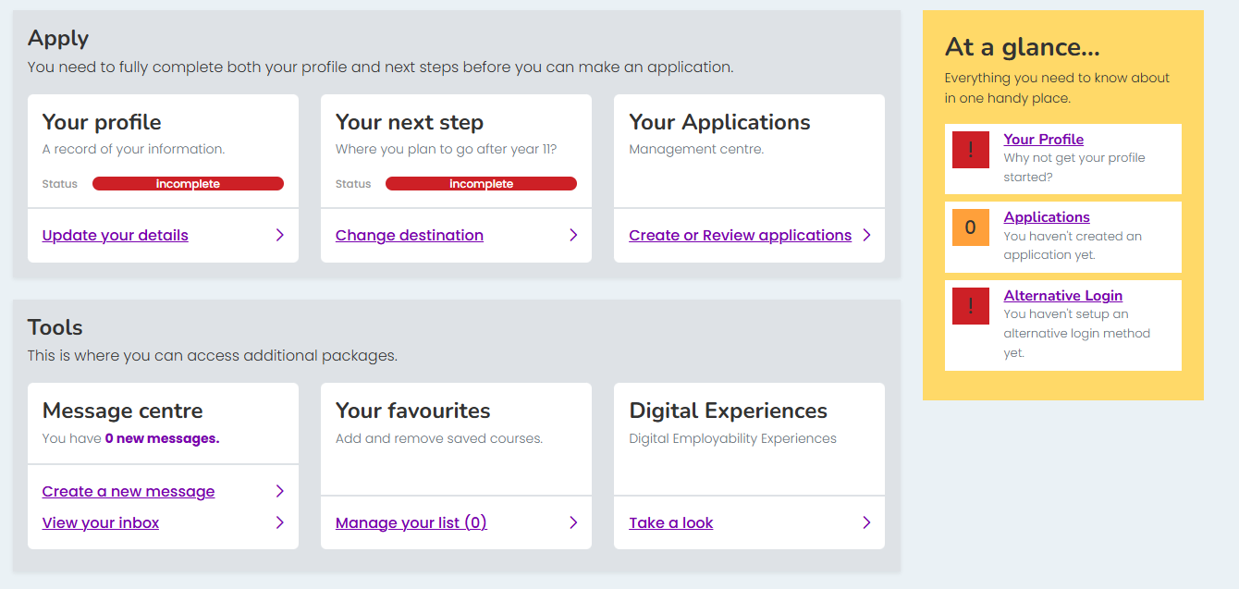

Alternative Login Set Up
Notes:
Let’s now set up an ‘alternative login’. This way you can easily access your account if you forget your username and password. Click Alternative Login

Slide 32
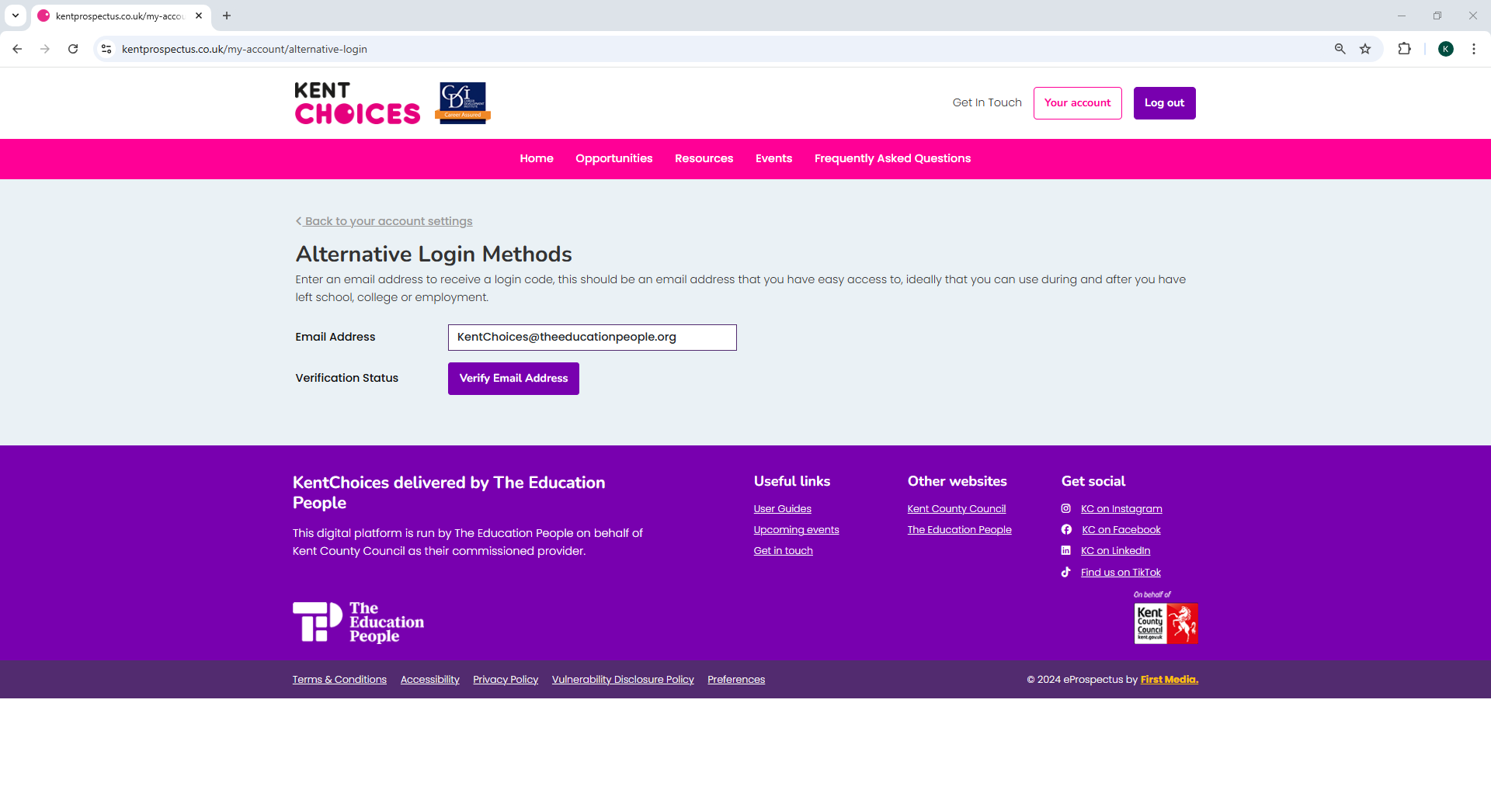
Notes:
Enter an email you have easy access to and click Verify

Slide 33
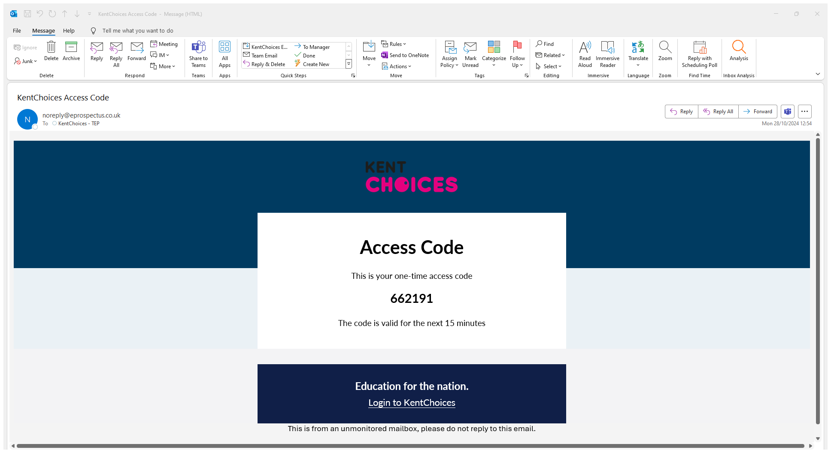
Notes:
Check your email for an access code

Slide 34
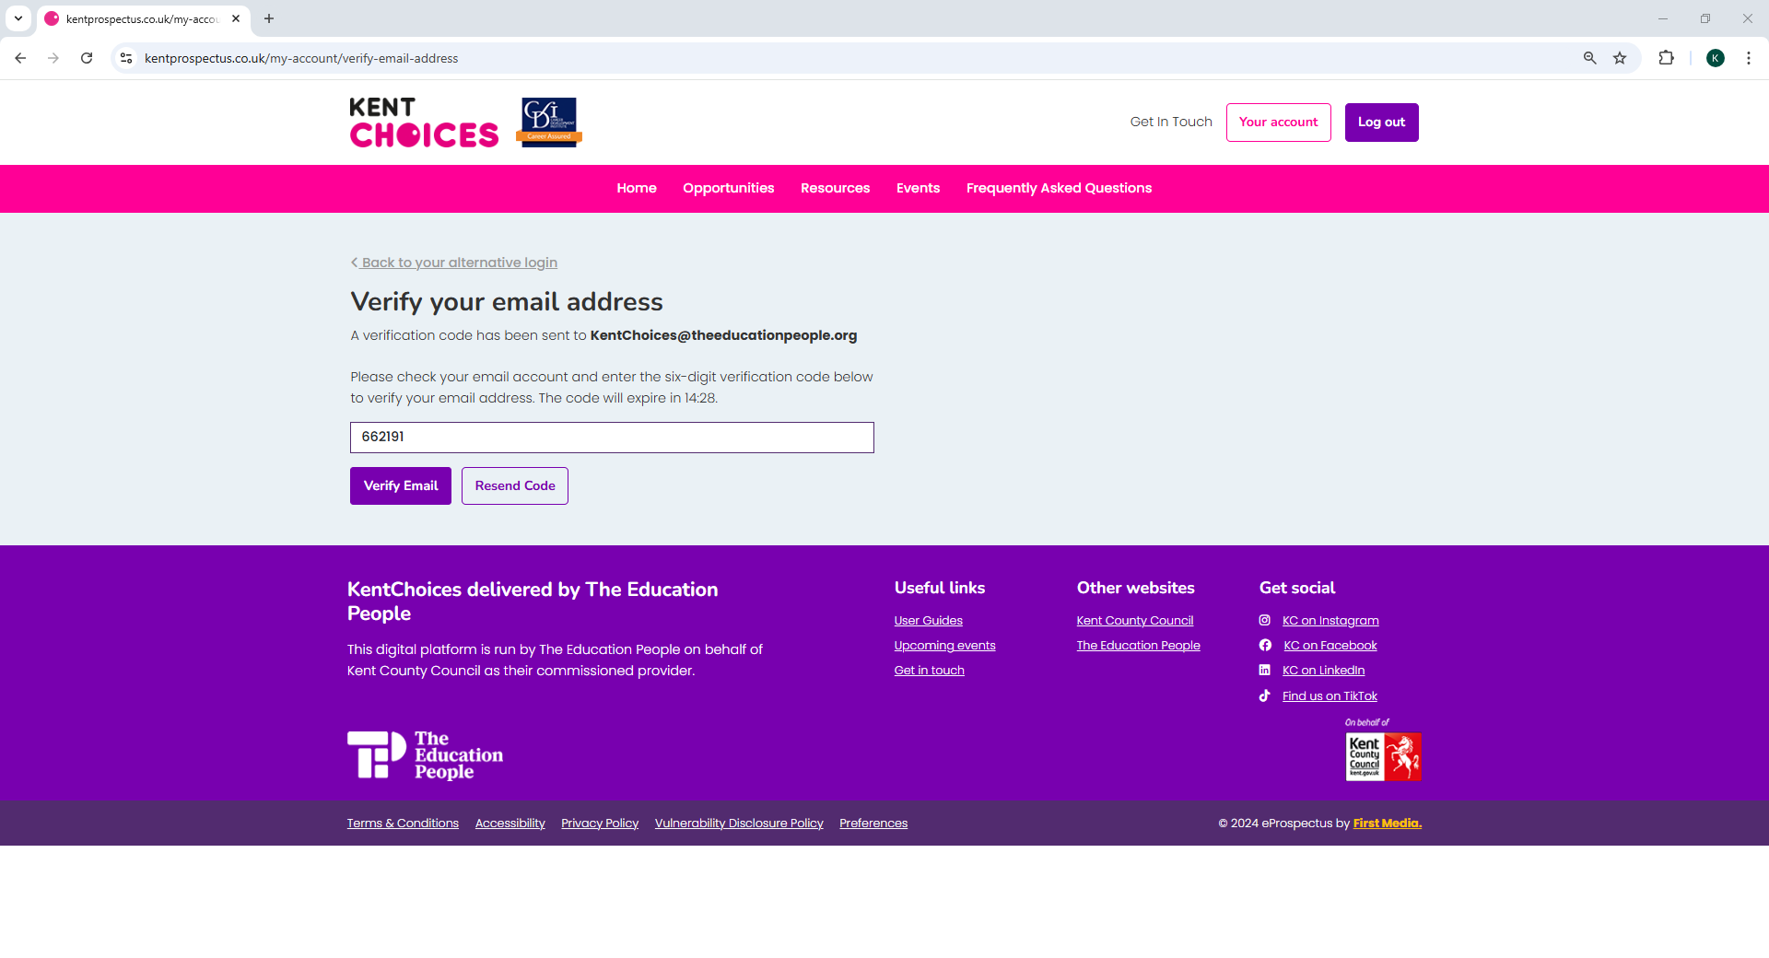
Notes:
Enter this code and click Verify Email

Slide 35
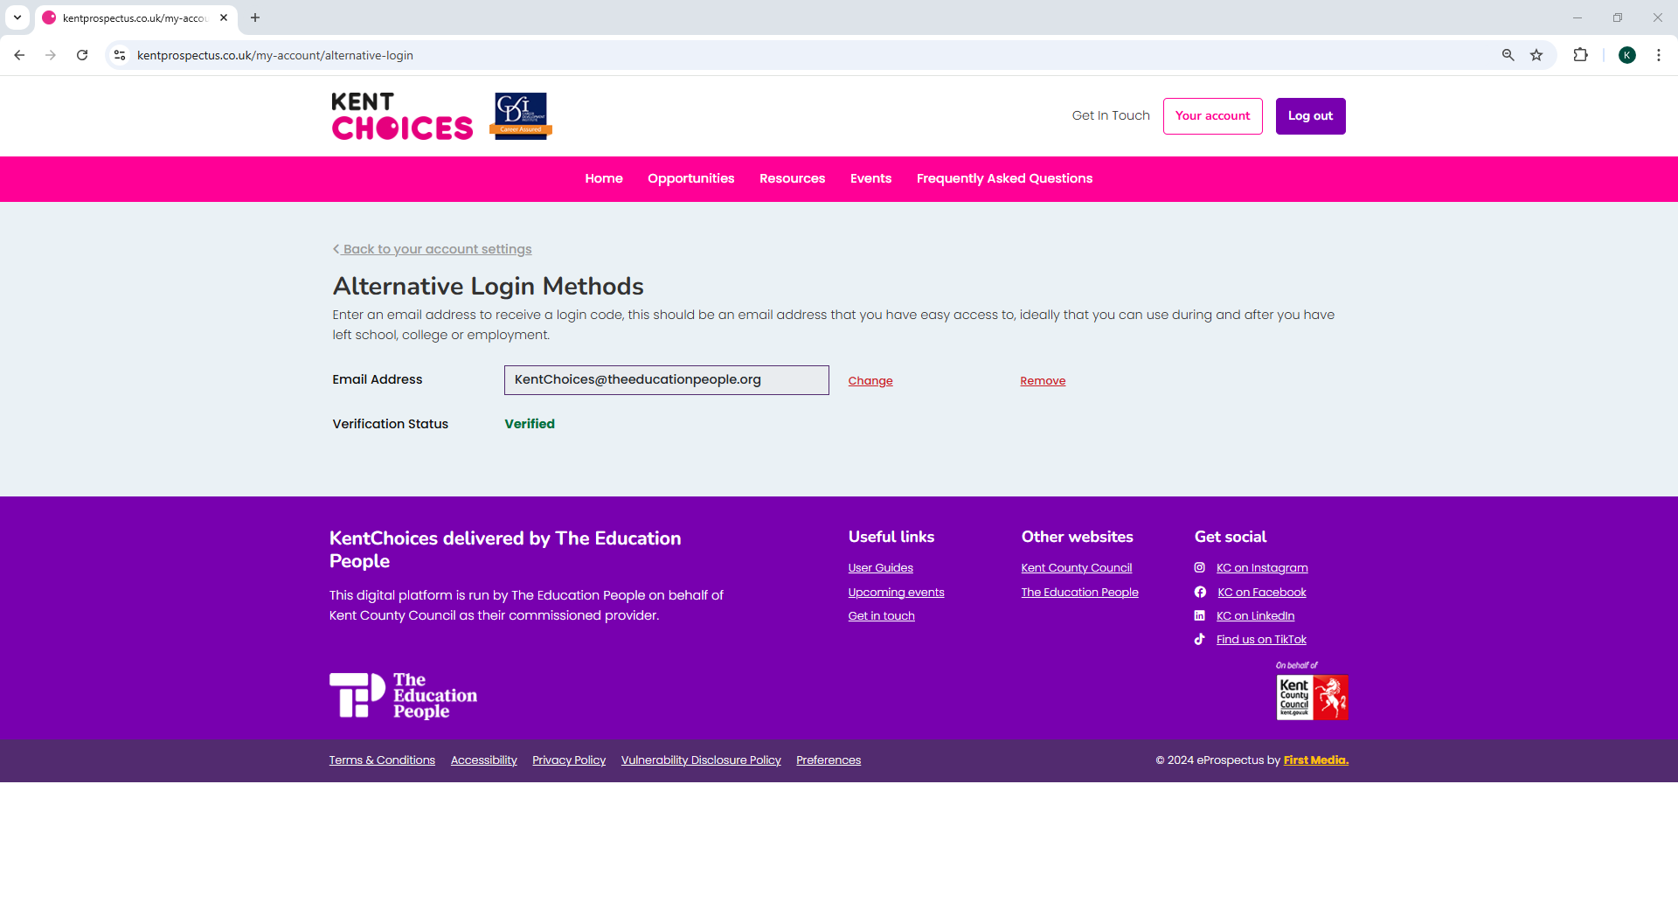
Notes:
Your alternative method is all now set up.

Slide 36
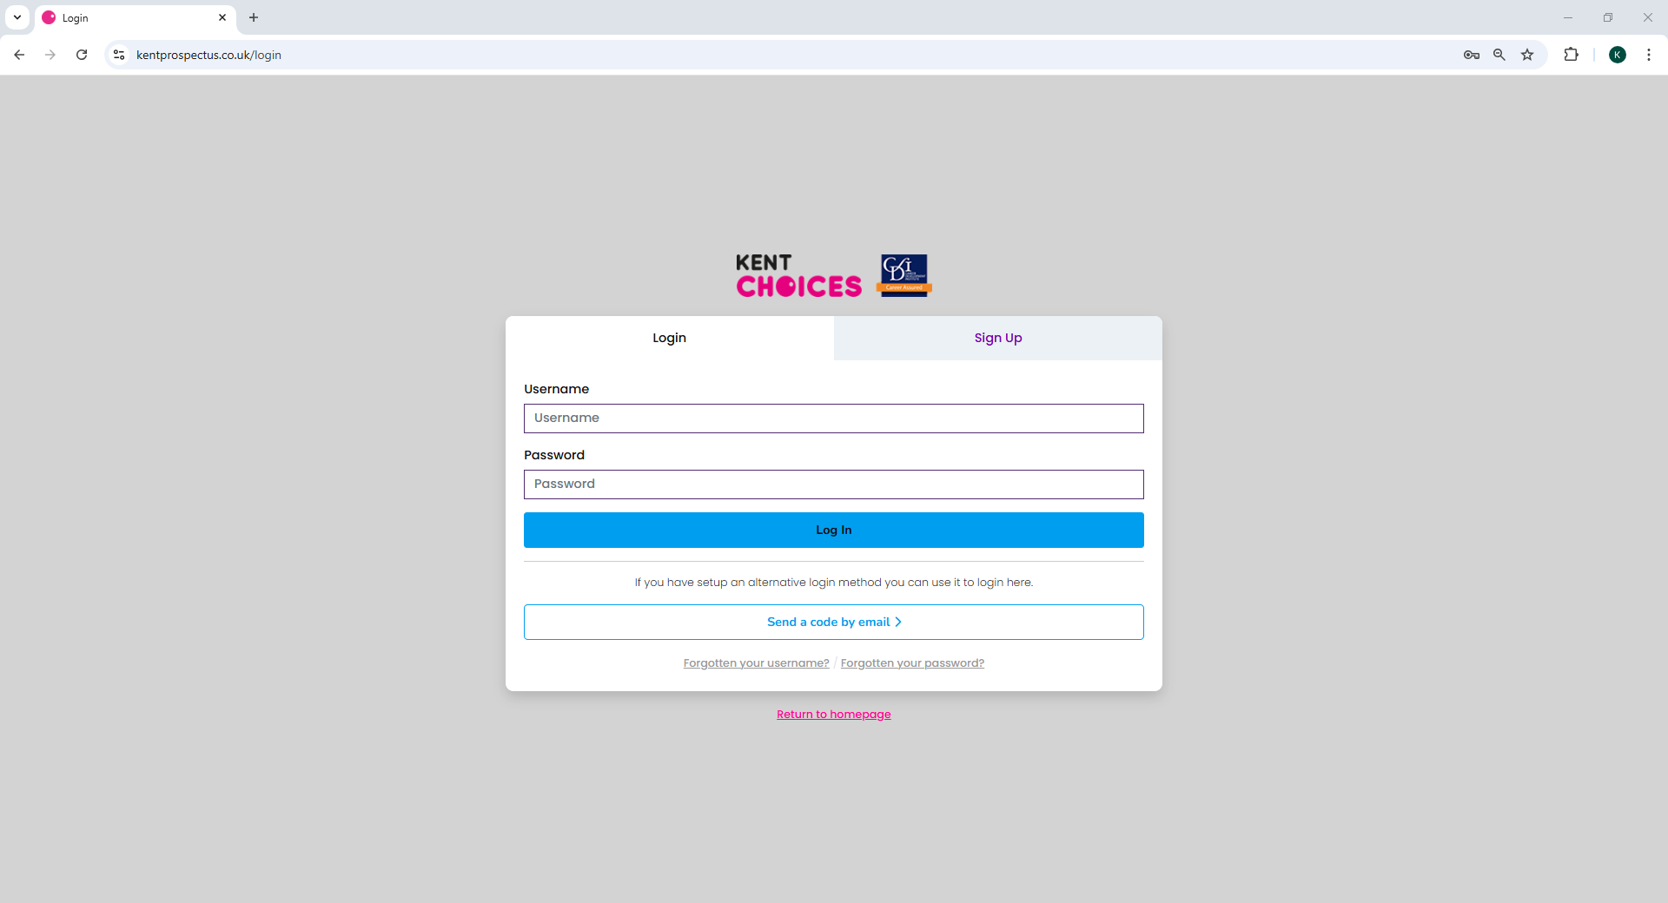
Notes:
You can now select this method to login with a one-time code instead of your username and password in the future.

Slide 37
Setting up your profile
(20 Minutes)

Slide 38
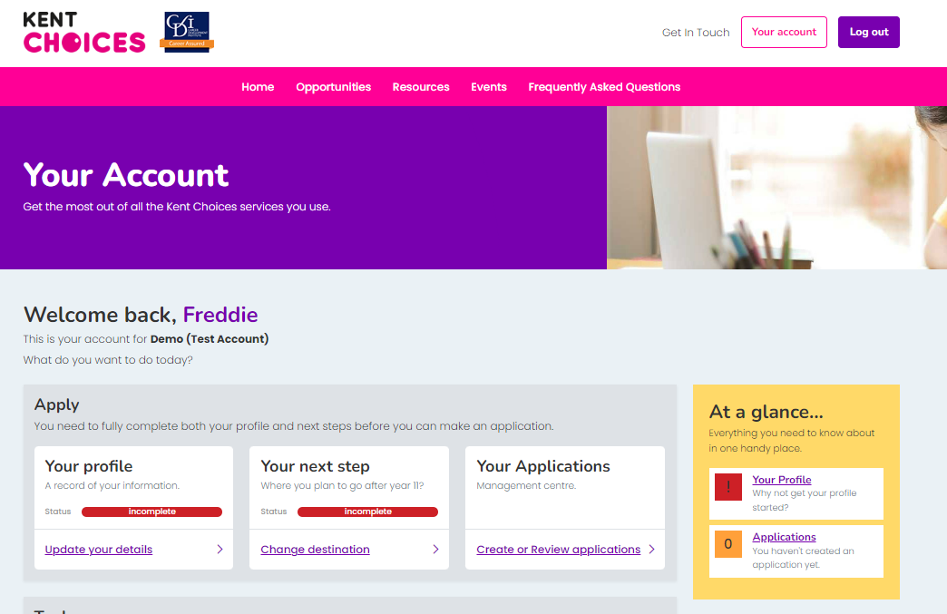


Your profile
Notes:
Click Your Account to take you back to your dashboard. Now let's update Your Profile.

Slide 39
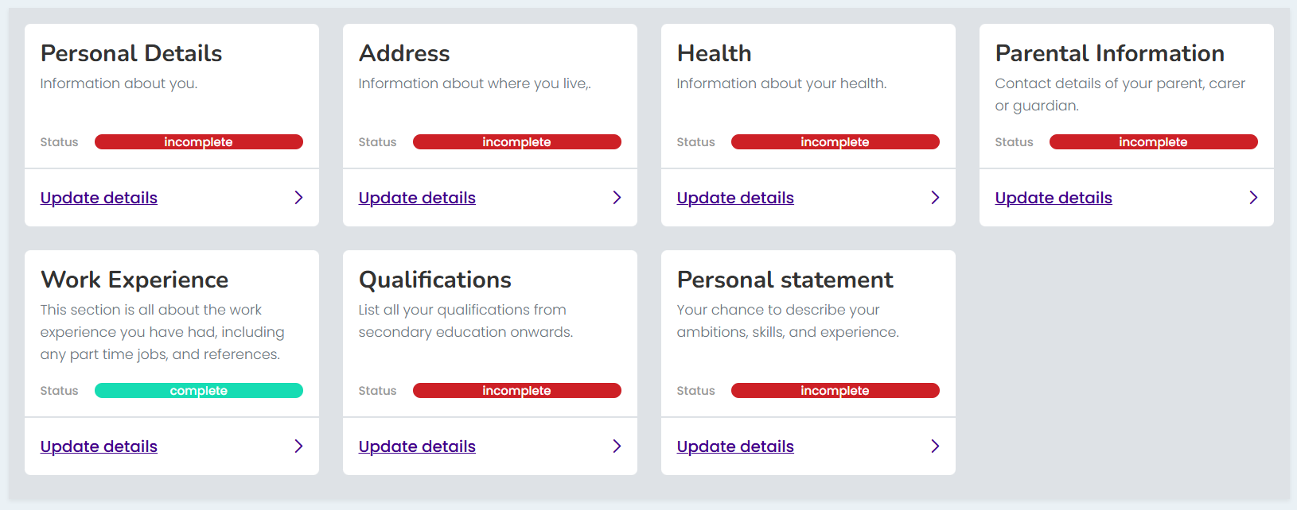


Complete your profile
Notes:
Work your way through each of the sections until they turn green***

Slide 40
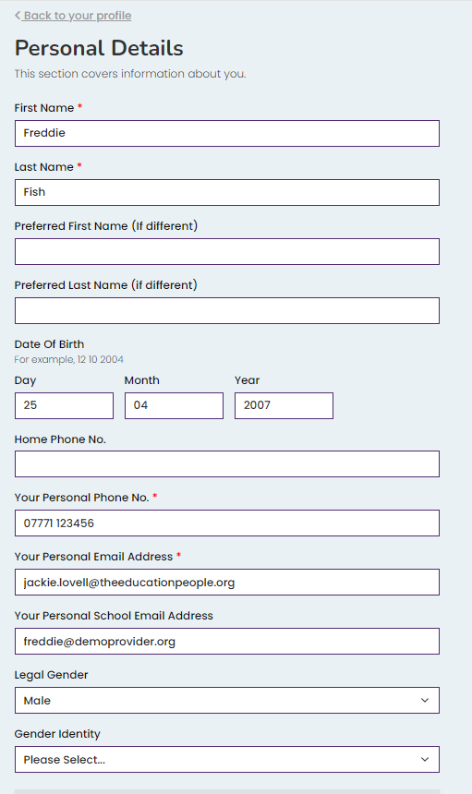
📱 Add your contact details 📧
*** IMPORTANT ***
Providers need to contact you!
Add a mobile number
Add at least one email address
Notes:
Make sure you add a telephone number and a personal or school email address, so sixth forms and colleges can contact you about your application.

Slide 41
Tips on completing your profile
📝 You need to complete all fields with a red *
📧 If you don’t know your parents email address,
add your own - you can update later
💼 Don’t forget to add any work experience!
Notes:
Here are a couple of top tips on completing your profile:
You need to complete all fields marked with a red asterisk
If you don’t know your parents email address you can enter your own for the time being – just remember to change this later.
Add any work experience you’ve done or if you are about to do.
Don’t worry if you can’t complete all the information, you can come back and update or add information later if you need to.

Slide 42
Keep it professional!
📧 Is your email address suitable?
🧾 Info helps schools/colleges make decisions
✏️ Check your spelling and grammar!
Notes:
Information you provide will be used to help sixth forms and colleges make a decision about your application so keep it professional and remember to check your spelling and grammar.

Slide 43
Tips on adding qualifications
🎓 Add an entry for each GCSE exam
🎯 Add your predicted grade or mock result
📆 Keep the Month 06 and Year 2026
Notes:
Tips on adding qualifications:
You need to add a separate entry for each GCSE exam you will be taking
Enter your predicted grade (usually 1 to 9) or the last grade you got for your mock exams.
Leave Predicted as the entry type but change the year to 2026
If you are not sure of your grades, you can come back later and add these but make sure you do this before you go on to apply.

Slide 44
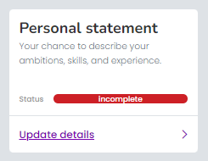
Leave the personal statement box blank for now…
In the next session, we will look at personal statements and submitting your application.

Slide 45
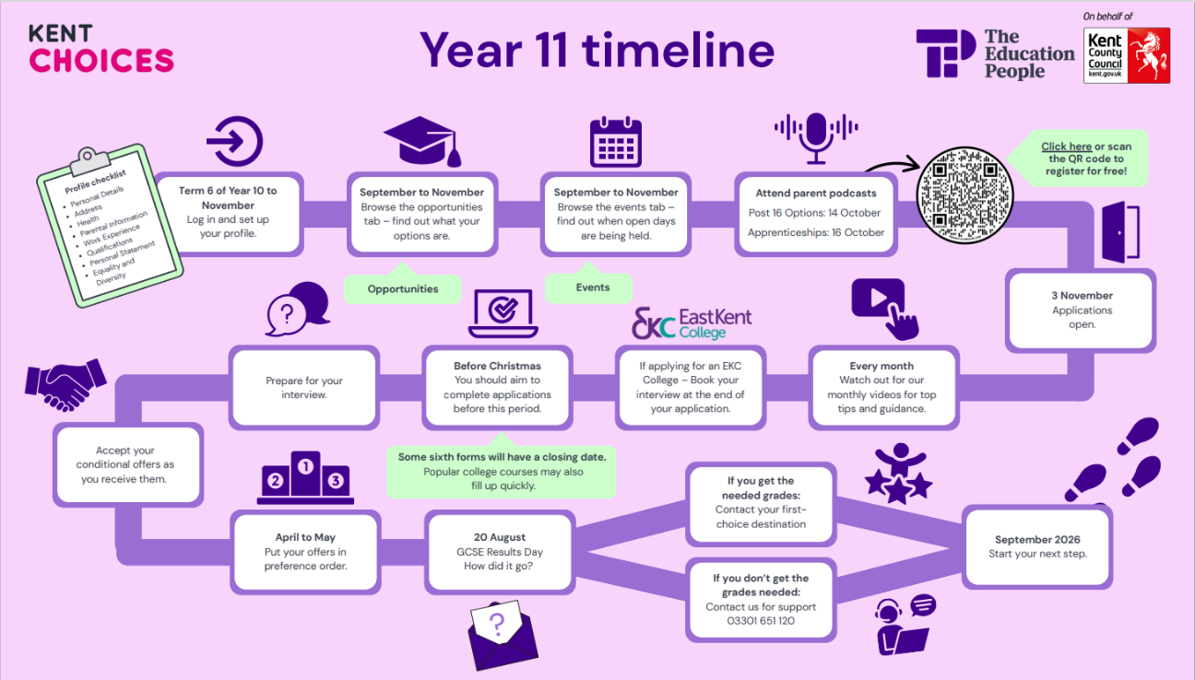

Slide 46
Homework
Come prepared to next session, with ideas on where you would like to apply to – ensure to discuss this with your parents/carers.

