Slide 1
KentChoices - Part 2: Personal Statements and Applying

Slide 2
KentChoices: Can you find?
Last lesson you spent time exploring KentChoices and setting up your profile.
Task:
Can you remember where you find key pieces of information? Using KentChoices, can you find the answers to these following questions?

Slide 3

Can you find?
When and where is the next open day happening in Kent?
What is the KentChoices phone number?
Which five courses does the ‘Demo School’ offer?
When do applications opens for ‘Demo School’?
What are
the entry requirements for Dog Grooming at ‘Demo School’?

Slide 4

Answers!
Check in ‘Events’ Tab
03301 651 120
Dog Grooming
Business Studies
Forensic Science
Criminology
Maths
4 GSCEs at Grade 5 or above – Including English and Maths
Monday 3rd November 2025

Slide 5

Date to remember
This is when applications open!
Top Tip: Some courses will be first come first serve, and others will have closing dates – so we always recommend you apply before Christmas.
Monday 3rd November 2025

Slide 6
Personal
Statements

Slide 7


What is a personal statement?
Definition:
A short piece of writing all about you – a chance to showcase your personality, skills, hobbies, interests and goals.
Purpose:
To provide a school/college more information, to support your application to their course – they want to know more than just your predicted grades!

Slide 8

Writing a Personal statement
Click here to watch: https://www.youtube.com/watch?v=F0GJCKjY9B8

Slide 9
Brainstorm:
What could you include in your personal statement?

Slide 10

What to include?
Introduce yourself
Favourite school subjects
Hobbies
Skills
Qualities
Interests
Goals
Future plans

Slide 11
Your Personal Statement Writing Guide:
To get you started...
I am a current Year 11 student at…
I would describe myself as…
I am really interested in…
Talking about school
One of my favourite subjects at school is… because…
For my GSCE subjects, I picked…
During (subject) we have recently studied…. and I enjoyed this because….
Talking about your hobbies
In my free time I enjoy….
Outside of school, I am part of a (sports) team…which has taught me
Through my hobbies I have developed…
Talking about your skills
One of my key strengths is…
I am a good (skill), for example…
My teachers would describe me as…
Talking about your achievements
An achievement I am proud of is…
A goal I have received achieved is…
I have been awarded…
Talking about your future
After completing this course, I hope to…
My ambition in life is….
I am interested in a career in…

Slide 12
Skills Word Bank
Determined | Patient | Resilient | Independent | Ambitious
Adaptable | Hard-working | Confident | Motivated | Kind
Supportive | Communicator | Organised | Reliable | Leader
Critical thinker | Focus | Creative | Problem Solver | Sporty

Slide 13

Example 1:
I am applying to sixth form because I would like the opportunity to continue my education and keep my options open. At school I have particularly enjoyed a range of subjects, especially English and Science, as they have helped me develop my thinking and communication skills.
Outside of school, I enjoy spending time with friends and keeping active, which has taught me the importance of balance and organisation.
I am proud of achieving good results in my recent assessments because they show the effort I put into my studies. One of my key strengths is that I am reliable and willing to work hard to improve.
I have chosen sixth form because I feel it will give me more time to decide what I want to do in the future. In the long term, I hope to explore different opportunities and find a pathway that suits my skills and interests.

Slide 14
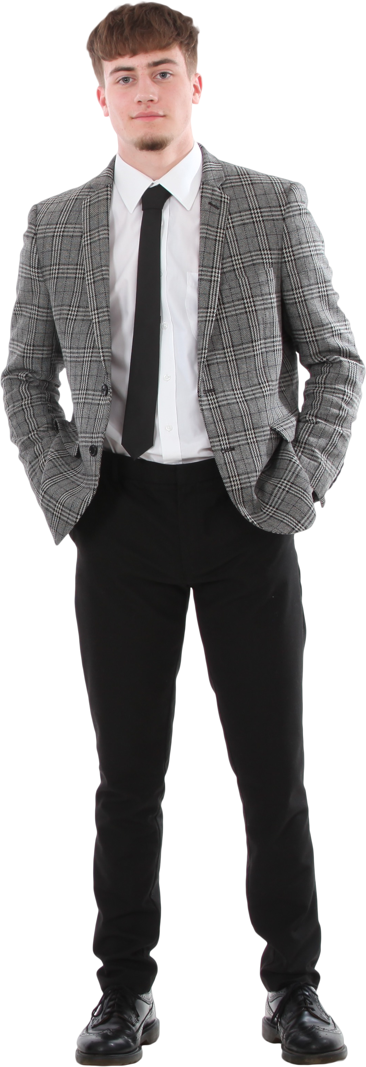
Example 2:
I am a current Year 11 student at Kent Choices School. At school I have particularly enjoyed PE because it allows me to challenge myself and work as part of a team. I also enjoy biology as I get to learn about the body, and how this could help in sports.
Outside of school, I play football for my local team which has helped me to develop my teamwork and leadership skills. I am proud of achieving ‘Player of the Season’ last year as it showed my commitment and hard work.
One of my key strengths is being determined and resilient, especially when training or competing.
I have chosen this course because I believe it will help me build the skills I need for a career in sports coaching. And in the future, I would like to progress into a sports-related career where I can continue to inspire and support others.

Slide 15





Top tips for your personal statement
Focus on your strengths
Highlight transferable skills
Express enthusiasm
Keep it concise
Ask someone to read through it

Slide 16
Making an application

Slide 17

Making an application
Click here to watch: https://www.youtube.com/watch?v=LwE_hp1fc34&feature=youtu.be

Slide 18
Application Tips:
Make sure to check when applications open and importantly close – you don’t want to miss any deadlines!
Remember to keep your personal statement general – it will go to all of your applications
Always proofread your personal statement!
When applying to 6th Forms generally you need to select at least 3 courses, for colleges it’s typically one course
If applying to East Kent College, remember to select an applicant day.
We recommend a minimum of 2 max of 5 applications (on KentChoices the limit is 8)
You will need to put your applications in preference order, but you can change this at any point.

Slide 19
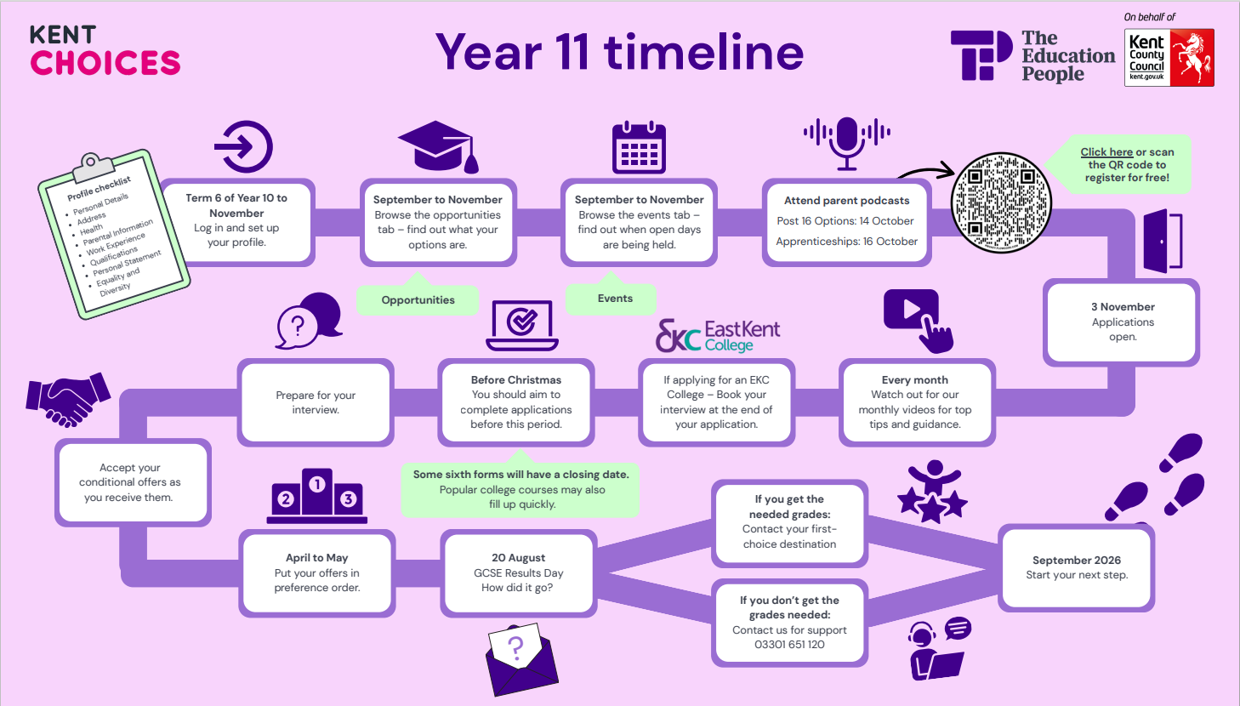

Slide 20
Next Steps:
Complete any unfinished areas of your profile.
Submit all your applications.
Book and attend your interviews.
Check your emails regularly for updates.
Accept your offers as you receive them.

Slide 21
For further support
KentChoices Team:
03301 651 120
Kentchoices@theeducationpeople.org

