Slide 1

Year 10 KentChoices Workshop:
Introduction to Post16 Options and
KentChoices

Slide 2
Year 10 KentChoices Workshop: Introduction to Post16 Options and KentChoices – Lesson plan
Materials needed: Access to computer Year 10 Log in Details | Student will require: Their KentChoices log in details Personal and parental contact details Predicted grades
Lesson aims: To develop students’ understanding of the full range of post-16 options available to them To introduce students to the KentChoices platform and demonstrate how to navigate it effectively To support students in setting up and completing their KentChoices profiles
Lesson time: one hour
Teaching content | Content details | Timings
Starter – Future Plans | Ice breaker activity, get the students to think about what they wanted to be when they were younger, and then where they want to be in 5 years time. This can be completed in pairs/small groups or a class. Lead into discussion that decision they make now, will impact those future plans. | 5 minutes.
Post-16 options | Part 1: Explore each of the Post-16 Options – Sixth form, college, apprenticeships, training and work with training. Part 2: Facilitate a short discussion about the positive and negatives and how to make the right decision for them. | 10 minutes.

Slide 3
Exploring KentChoices | Explore the information pages on KentChoices – Opportunities search, Events (open days), course/school pages, resources. Students to be given 5 minutes to explore the KentChoices website Ask students to feedback what they have found, what they thought was interesting, what they couldn’t find, if they have any questions. *No log in details are required for this section. | 10 minutes.
Providing log in details | Provide young people with their log in details, encourage young people to set up the alternative login method. | 10 minutes
Setting up KentChoices profiles | Using the slides, explore setting up a KentChoices profile – highlighting the top tips for contact details, predicted grades and personal statement writing frame. (5minutes) Students to be given 15 minutes to complete their profile. Students to complete each of the 7 boxes on the profile. | 20 minutes.
Timeline and next steps | Discuss with students the timeline of Year 10/Year 11, and key point in the transition ahead. Highlight the key next steps and action points. Highlight to further support if needed. | 5 minutes.

Slide 4









What did you want to be when you were younger?

Slide 5
Where do you want to be in five years time?
Now you need to work backwards

Slide 6

The options
Work with training
Sixth form
College
Training
Apprenticeships

Slide 7









The future
Things to consider
Familiar Environment
Subjects
Entry requirements
Learning Setting
Friends
Family
Pathways
Notes:
Brief overview of what will impact their choices

Slide 8

Sixth form

Slide 9
Sixth form
Familiar – your own school
Change - different school and some colleges
Multiple subjects – 2/3
Classroom based
Entry requirements – Generally grade 4/5s in Maths and English
Dress code – Formal
Choice of future pathways

Slide 10
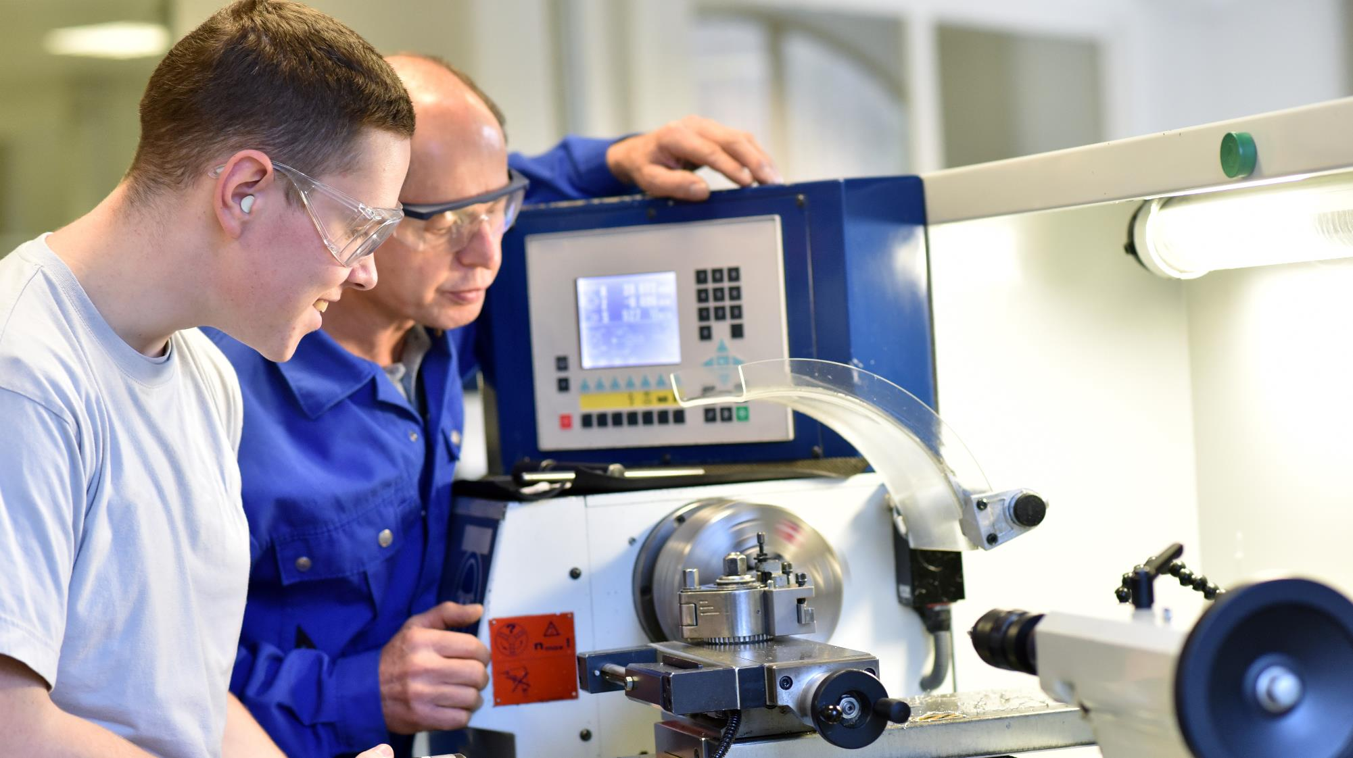

\
College

Slide 11
College
Change of environment
Vocational (some colleges also offer sixth form)
Timetable – 2/3 days a week
Entry requirements - Vary
Dress code – Course dependent
Choice of future pathways

Slide 12









Slide 13

Apprenticeships

Slide 14
“Earn and learn”
80%
20%
Paid employment
Training and study
Hands on
Recognised qualification
Age 16+

Slide 15




The training
One day a week (or equivalent) in formal training (20%).
Gain skills needed to complete the qualifications.
Theory learning and support with assignment work.
Practical training

Slide 16
The levels
Level 2
Level 3
Level 4/5/6/7
Intermediate
Equivalent to 5 GCSEs.
Entry Requirements vary.
You may not need grade 4 and above.
Advanced
Equivalent to two A Levels.
Entry Requirements vary.
You will need a grade 4 and above.
Higher/Degree
Equivalent to Foundation, Bachelors or Masters.
Entry requirements vary.

Slide 17

The money
Since April 2026, the minimum hourly wage is £8 an hour.
This is reviewed each year.

Slide 18



What else do you gain?
\\
Practical skills.
Professional mentors.
Recognised qualifications.

Slide 19

Training Providers

Slide 20














Training Providers
Lighthouse on The Marsh
Smaller environments
Maths and English
Specialist focus
Work experience
Choice of future pathways

Slide 21
Work with training
Can be put in place in a unique situation.
A combination of employment alongside formal training.
Hours of employment and training must meet the government guidelines.
Seek support from your careers lead for further information.

Slide 22
Discussion
(2 Minutes)
What are the positives and negatives of each option?
Will there be one ‘right’ path for everyone?
What do you need to consider to find the right path for you?

Slide 23


KentChoices

Slide 24




What is KentChoices?
Search
Apply
Open Days
Get Help

Slide 25
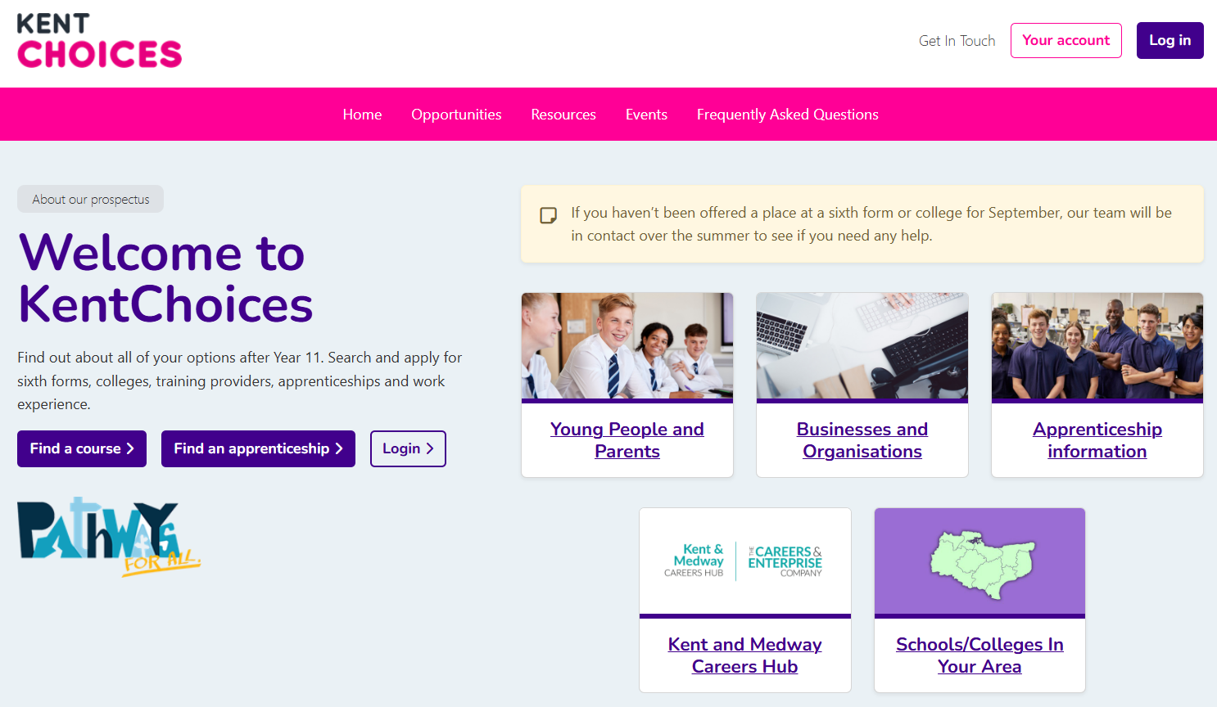

Slide 26


Slide 27
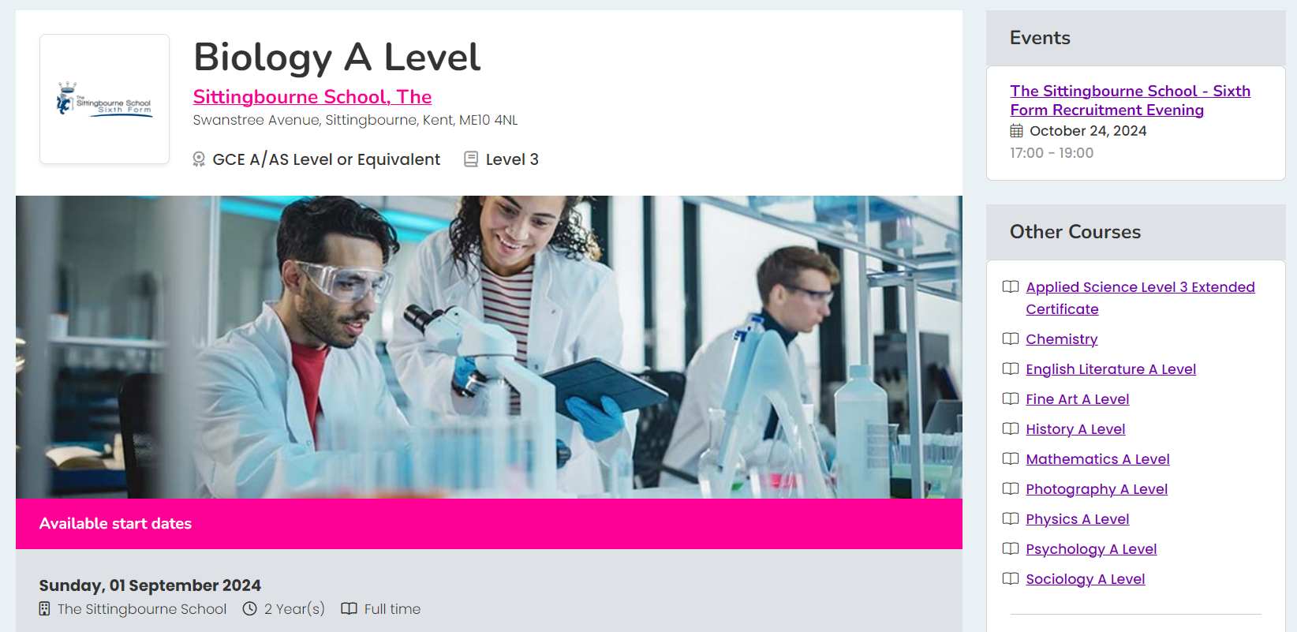
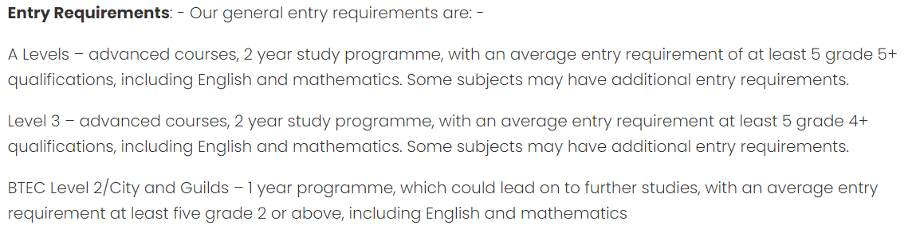

Slide 28
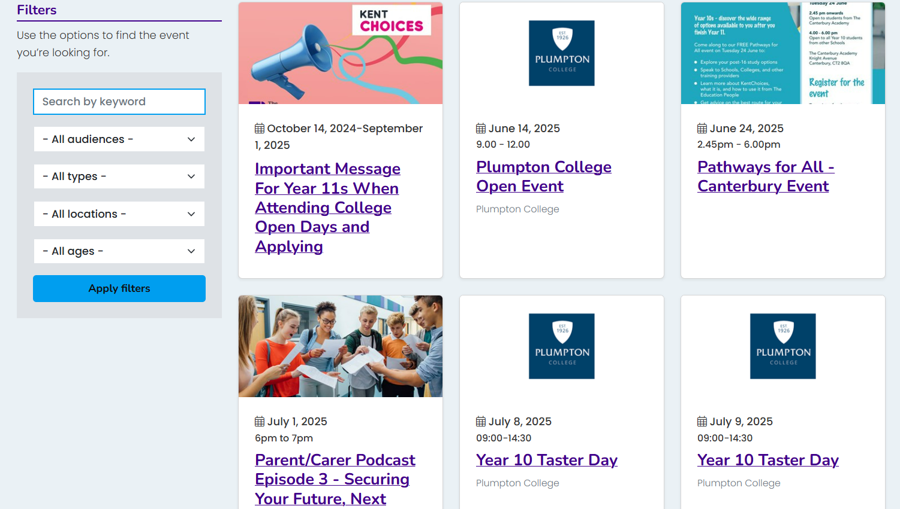

Slide 29
Activity (5 Minutes)
🕵️‍♂️ Explore the website
🏫 Find local open events
🔎 Search for courses/check entry requirements

Slide 30
Getting logged in

Slide 31
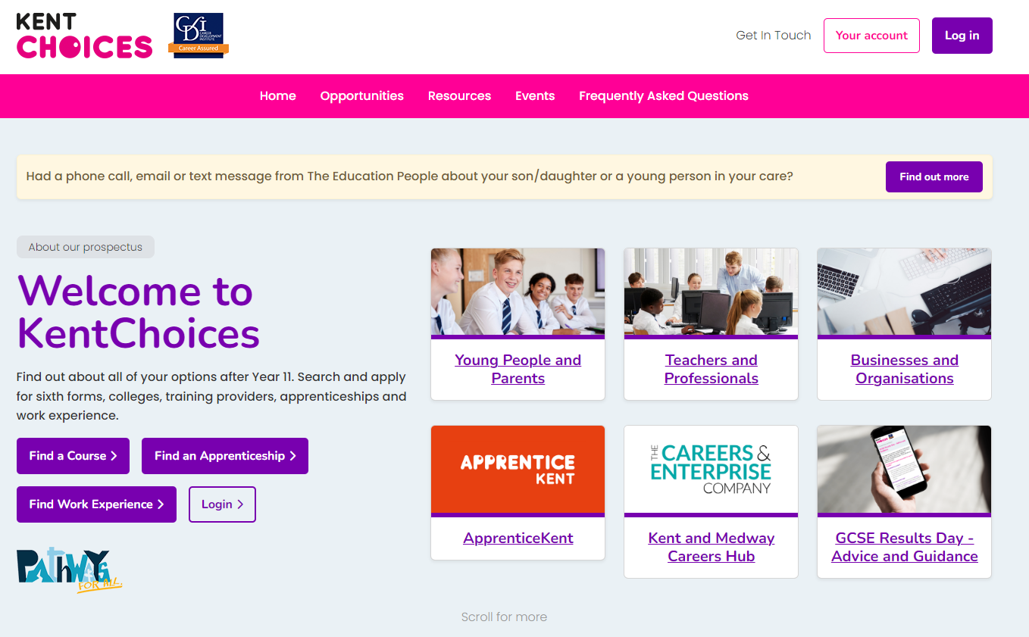
KentChoices.co.uk
Notes:
Go to KentChoices.co.uk and click Log in* to get started

Slide 32
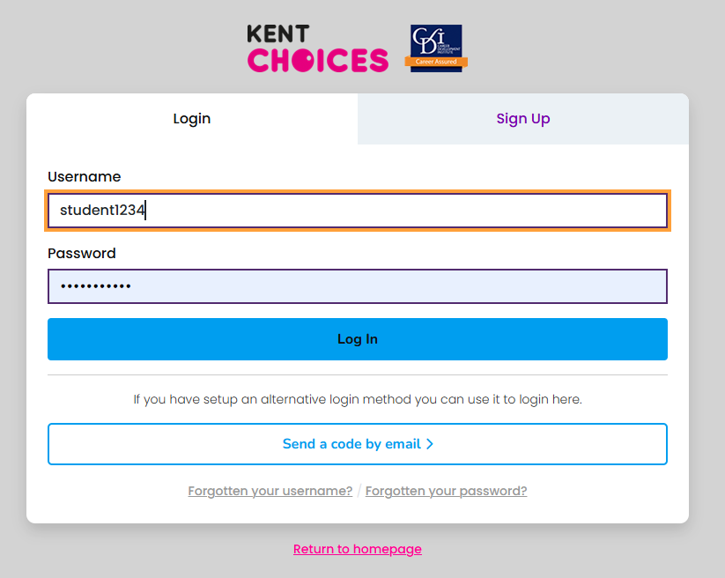
Log in

Slide 33

Agree to Terms and Conditions
Notes:
Agree to the terms and conditions.

Slide 34
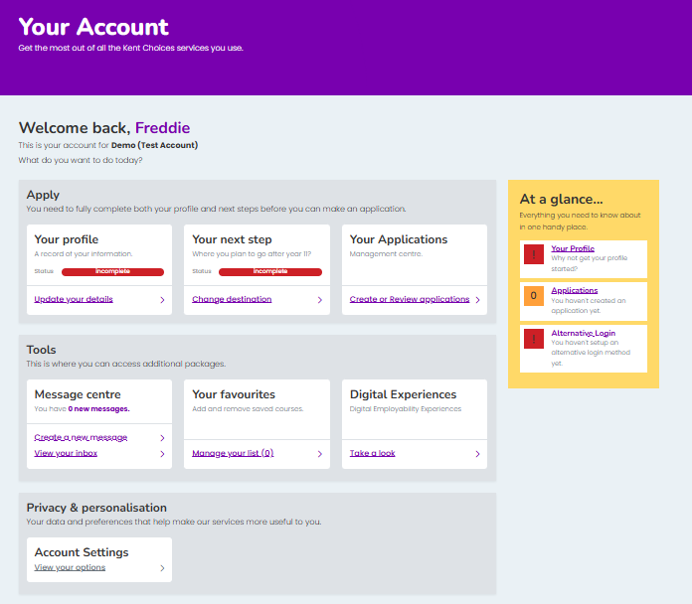
Your Account - Dashboard
Notes:
This is Your Account Dashboard

Slide 35
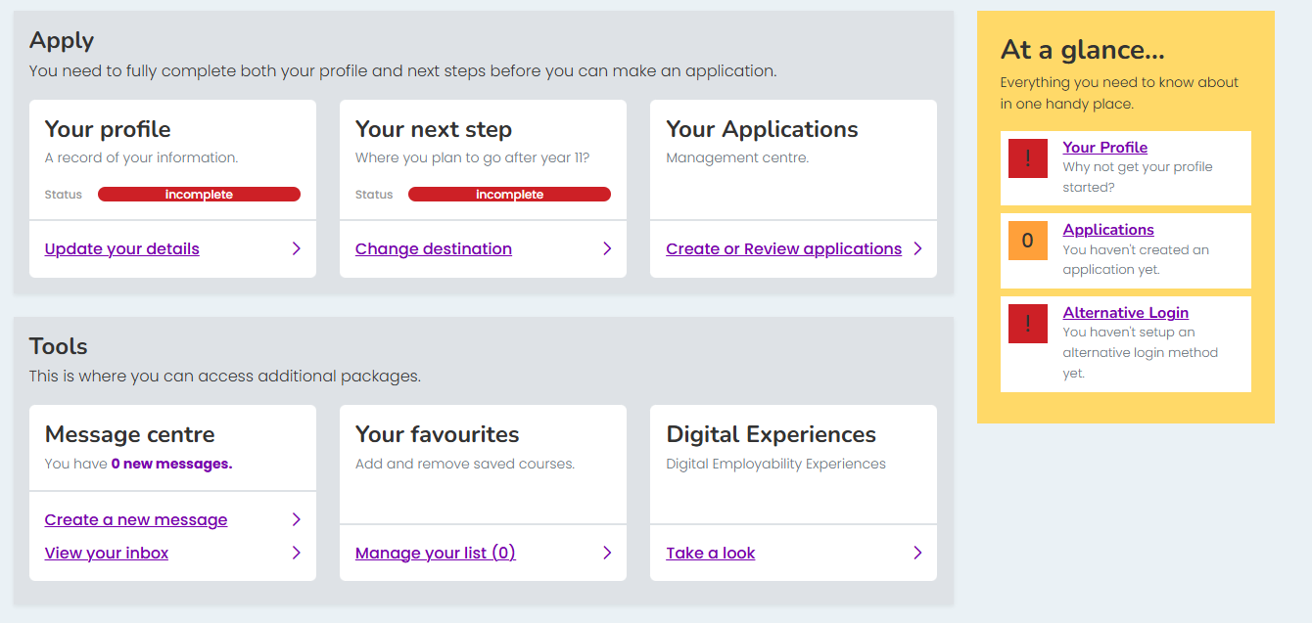
Alternative Login Set Up
Notes:
Let’s now set up an ‘alternative login’. This way you can easily access your account if you forget your username and password. Click Alternative Login

Slide 36
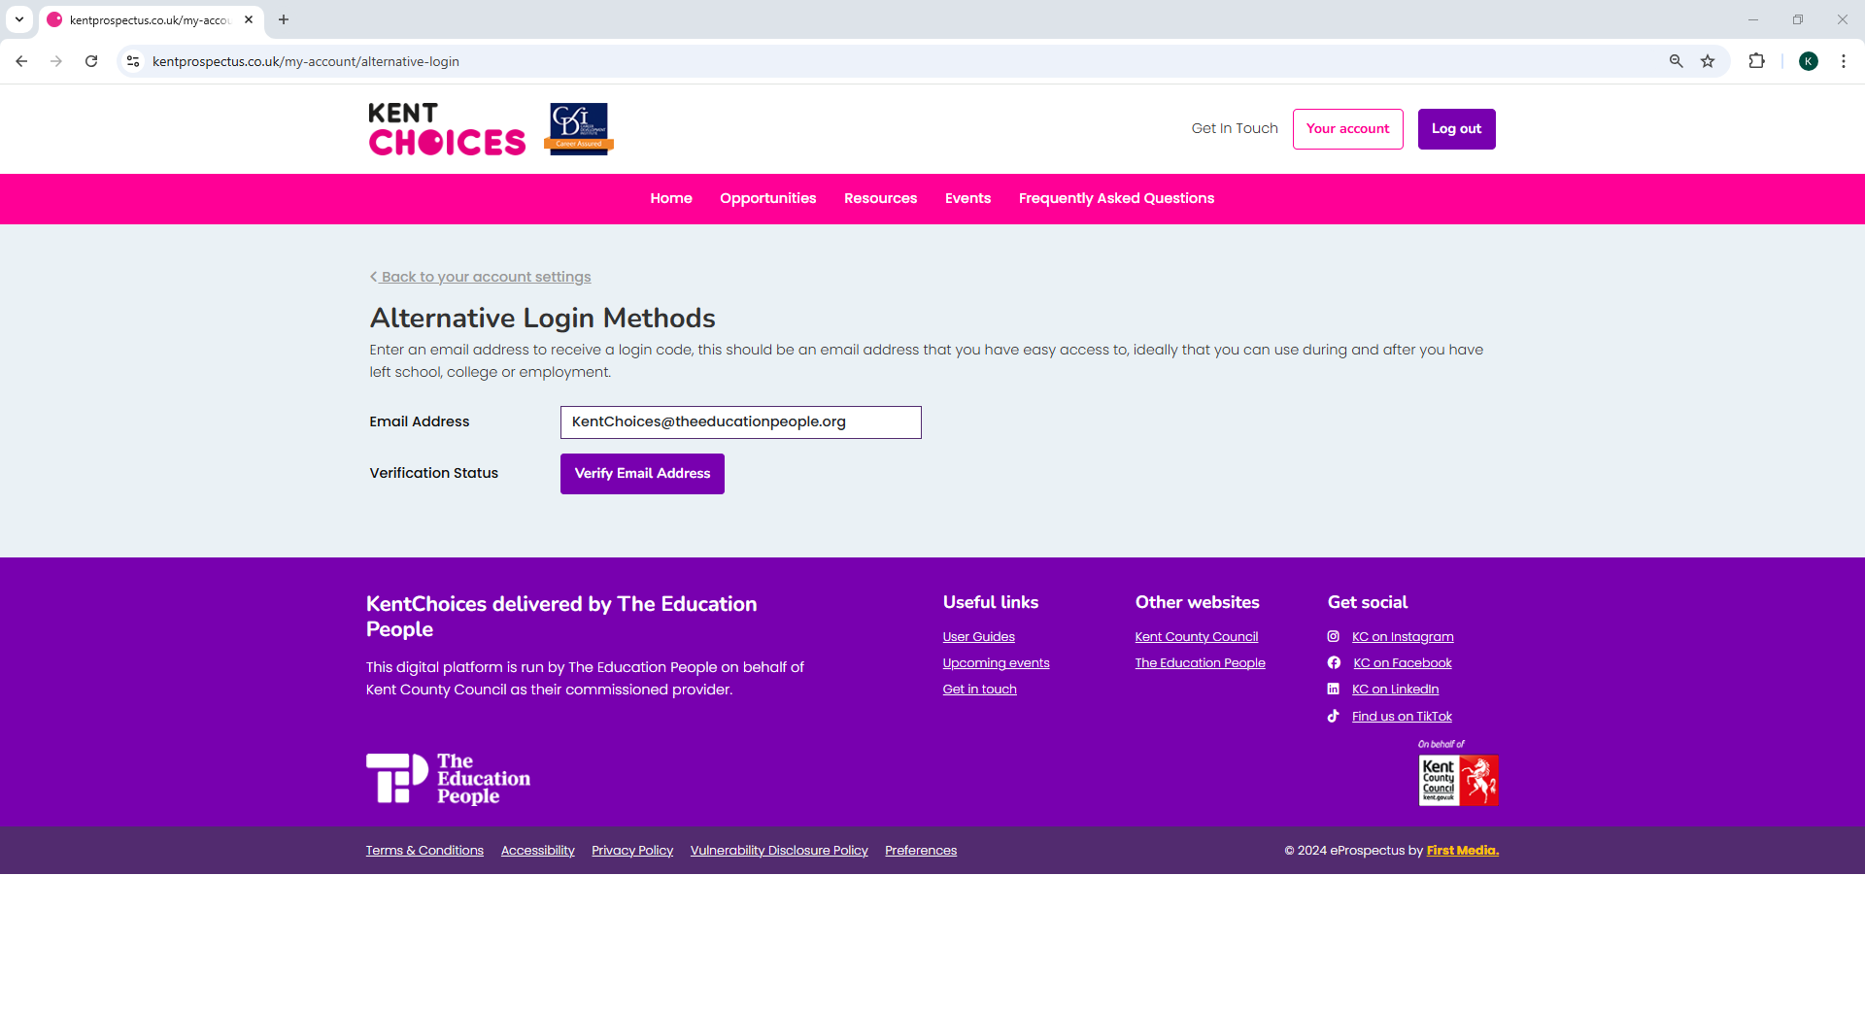
Notes:
Enter an email you have easy access to and click Verify

Slide 37
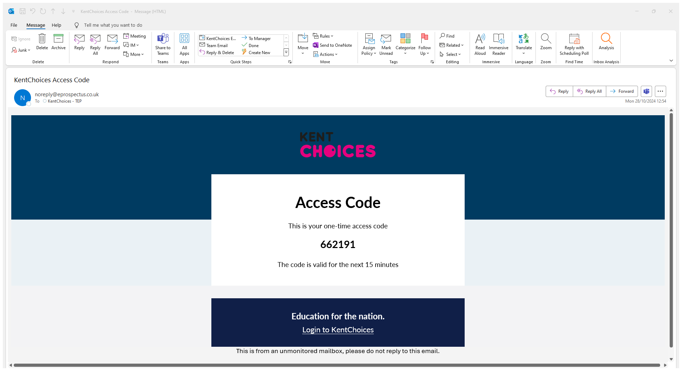
Notes:
Check your email for an access code

Slide 38
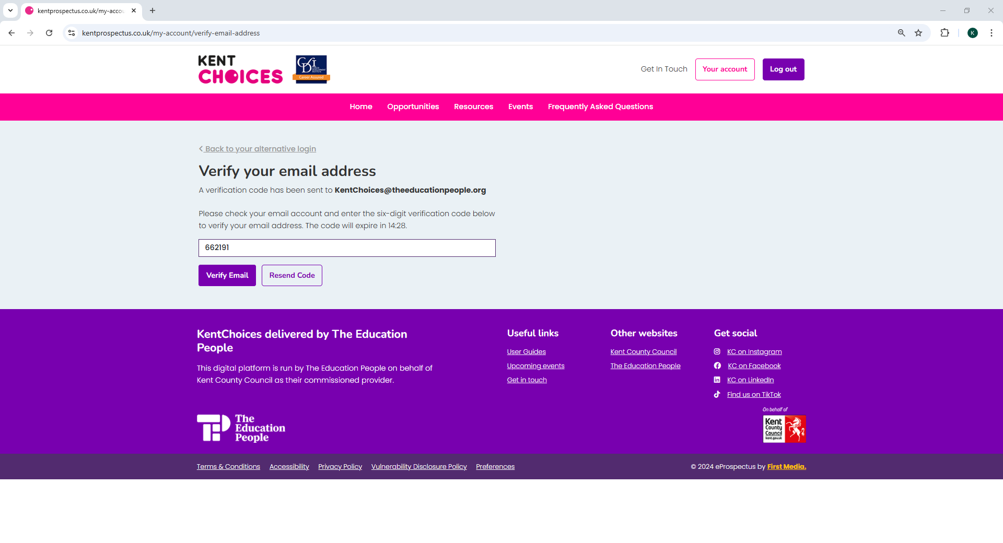
Notes:
Enter this code and click Verify Email

Slide 39
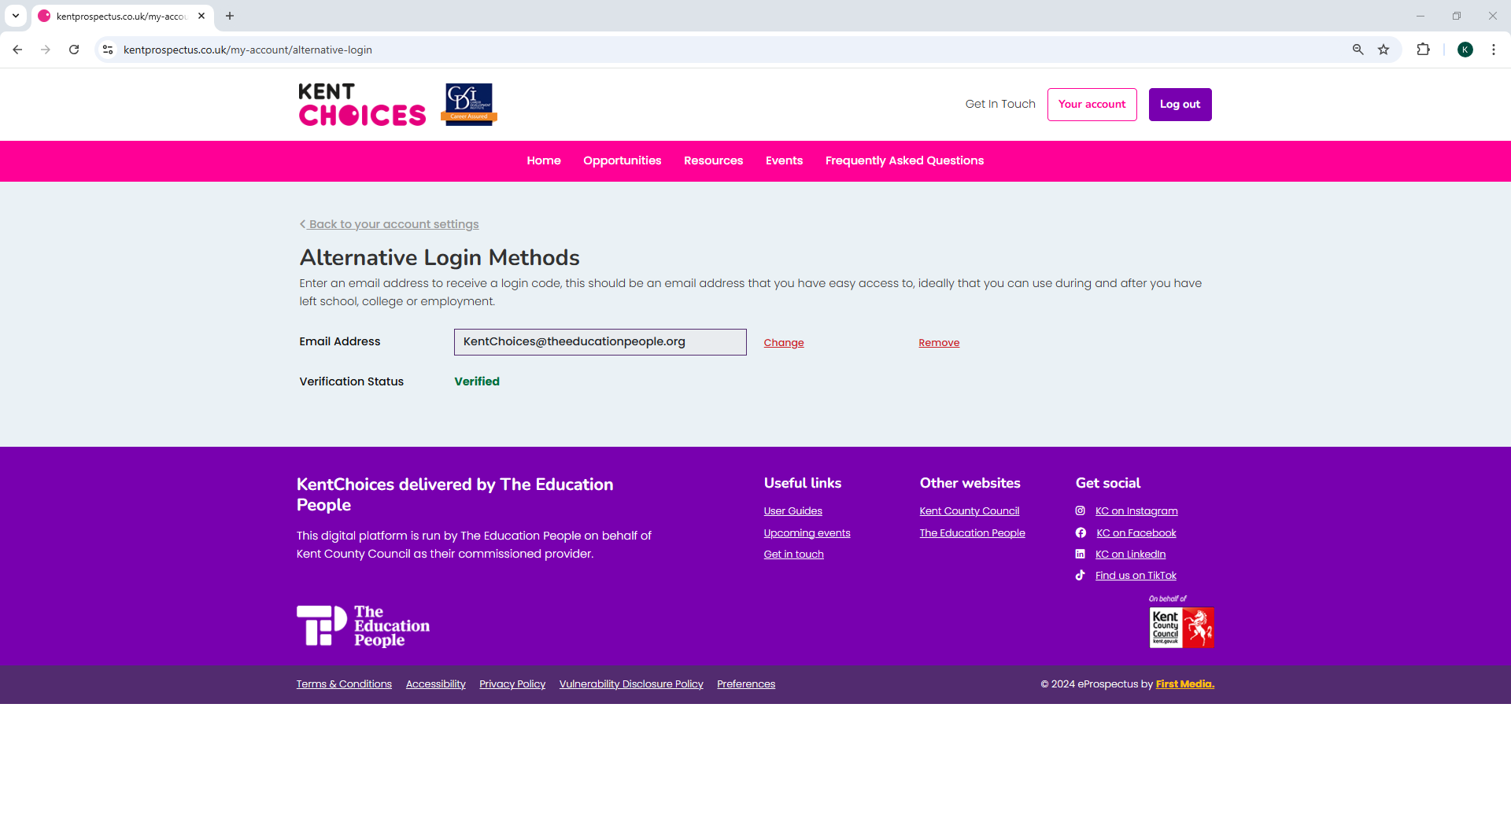
Notes:
Your alternative method is all now set up.

Slide 40
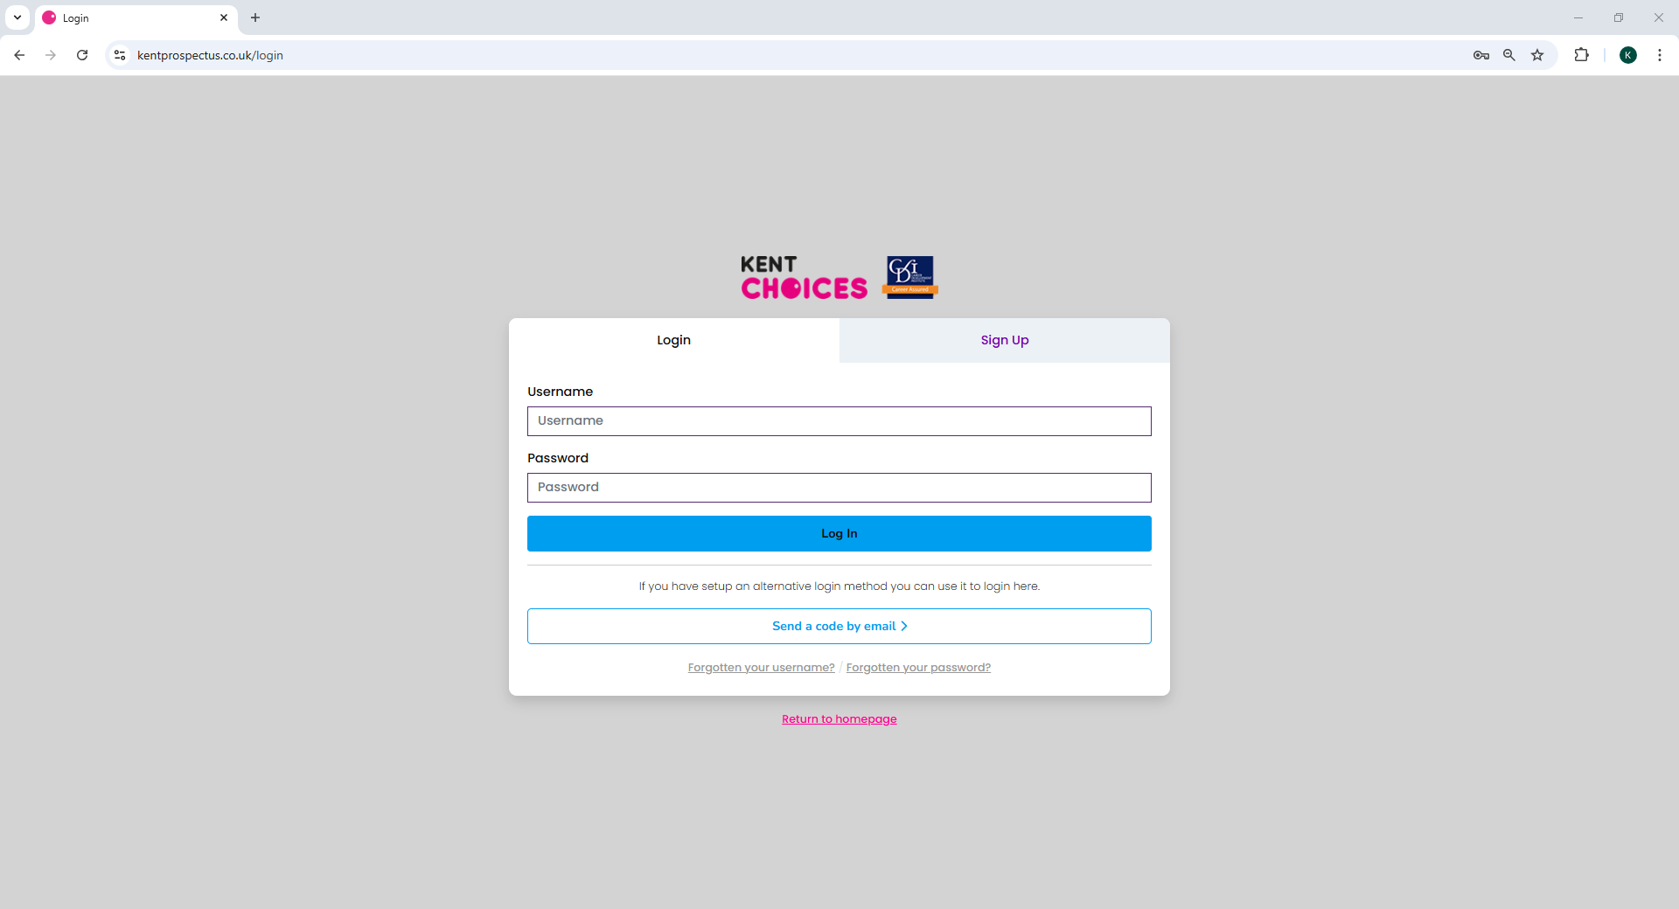
Notes:
You can now select this method to login with a one-time code instead of your username and password in the future.

Slide 41
Setting up your profile

Slide 42
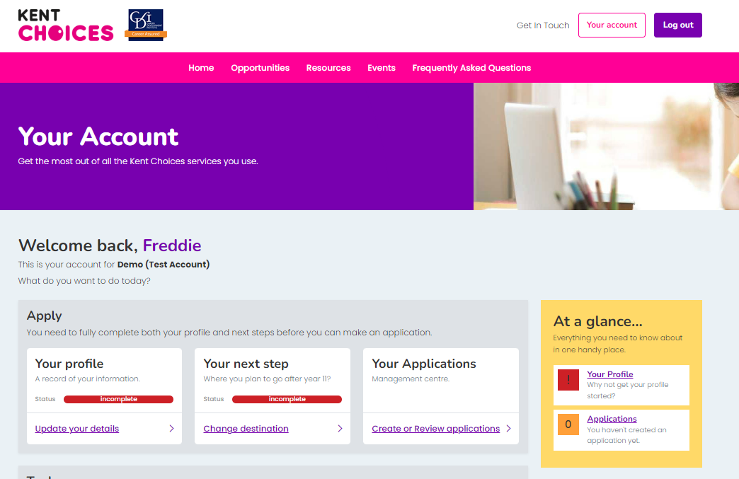
Your profile
Notes:
Click Your Account to take you back to your dashboard. Now let's update Your Profile.

Slide 43
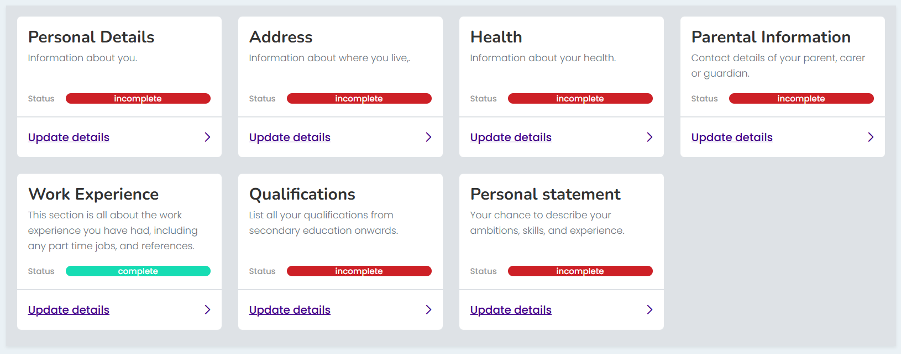
Complete your profile
Notes:
Work your way through each of the sections until they turn green***

Slide 44
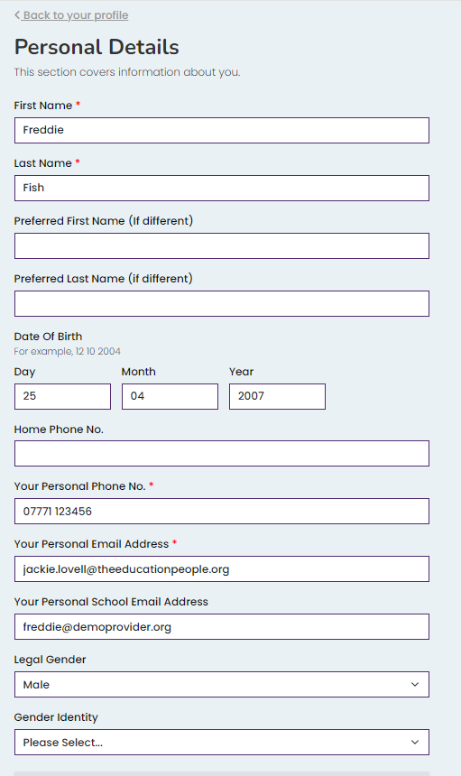
📱 Add your contact details 📧
*** IMPORTANT ***
Providers need to contact you!
Add a mobile number
Add at least one email address
Notes:
Make sure you add a telephone number and a personal or school email address, so sixth forms and colleges can contact you about your application.

Slide 45
Tips on completing your profile
📝 You need to complete all fields with a red *
📧 If you don’t know your parents email address,
add your own - you can update later
💼 Don’t forget to add any work experience!
Notes:
Here are a couple of top tips on completing your profile:
You need to complete all fields marked with a red asterisk
If you don’t know your parents email address you can enter your own for the time being – just remember to change this later.
Add any work experience you’ve done or if you are about to do.
Don’t worry if you can’t complete all the information, you can come back and update or add information later if you need to.

Slide 46
Keep it professional!
📧 Is your email address suitable?
🧾 Info helps schools/colleges make decisions
✏️ Check your spelling and grammar!
Notes:
Information you provide will be used to help sixth forms and colleges make a decision about your application so keep it professional and remember to check your spelling and grammar.

Slide 47
Tips on adding qualifications
🎓 Add an entry for each GCSE exam
🎯 Add your predicted grade or mock result
📆 Keep the Month 06 and Year 2027
Notes:
Tips on adding qualifications:
You need to add a separate entry for each GCSE exam you will be taking
Enter your predicted grade (usually 1 to 9) or the last grade you got for your mock exams.
Leave Predicted as the entry type but change the year to 2026
If you are not sure of your grades, you can come back later and add these but make sure you do this before you go on to apply.

Slide 48
Personal
Statements

Slide 49
What is a personal statement?
Definition:
A short piece of writing all about you – a chance to showcase your personality, skills, hobbies, interests and goals.
Purpose:
To provide a school/college more information, to support your application to their course – they want to know more than just your predicted grades!

Slide 50
What to include?
Introduce yourself
Favourite school subjects
Hobbies
Skills
Qualities
Interests
Goals
Future plans

Slide 51
Top tips for your personal statement
Focus on your strengths
Highlight transferable skills
Express enthusiasm
Keep it concise
Ask someone to read through it

Slide 52
Your Personal Statement Writing Guide:
To get you started...
I am a current Year 11 student at…
I would describe myself as…
I am really interested in…
Talking about school
One of my favourite subjects at school is… because…
For my GSCE subjects, I picked…
During (subject) we have recently studied…. and I enjoyed this because….
Talking about your hobbies
In my free time I enjoy….
Outside of school, I am part of a (sports) team…which has taught me
Through my hobbies I have developed…
Talking about your skills
One of my key strengths is…
I am a good (skill), for example…
My teachers would describe me as…
Talking about your achievements
An achievement I am proud of is…
A goal I have received achieved is…
I have been awarded…
Talking about your future
After completing this course, I hope to…
My ambition in life is….
I am interested in a career in…

Slide 53
Task: Complete your profile
15 Minutes

Slide 54






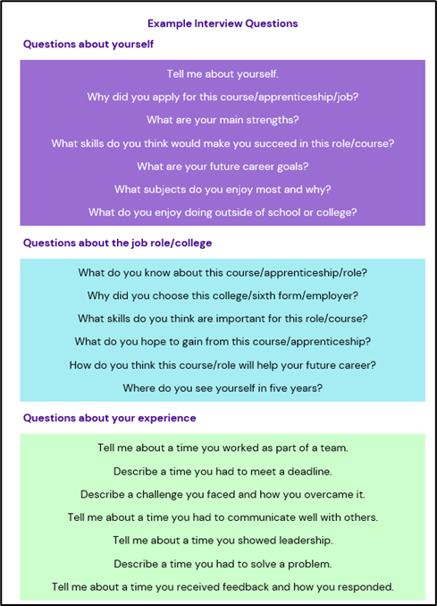



Next steps timeline- Year 10
Term 6
Summer
Summer
September
Term 6
Start exploring different career pathways.
Find out what your options are.
Explore the National Careers Service and Amazing Apprenticeships to learn more about different career and apprenticeship pathways.
Say ‘YES’ to experiences, and build your transferable skills.
Browse the events tab on KentChoices to find out about College and sixth Form open days
Term 6 of Year 10. Log in & set up KentChoices profile.
November
October
Check KentChoices for videos and guidance.
Most applications open at start of November- closing dates will vary- check when these are.
Prepare for interviews- guidance available on KentChoices
Make a back up application –places can fill up fast!
Make sure your profiles are up to date ready to make applications
Spring 2027
August 2027
September 2027
November
Accept your conditional offers as you receive them.
Attend interviews – remember to practice!
Put your offers in preference order
Results day… how did it go?
Start your next steps

Slide 55
For further support
KentChoices Team:
03301 651 120
Kentchoices@theeducationpeople.org

